Slide 1
Common Abbreviations Of Everyday English
Asst. Lect. Zhala Abdulqader
MA in English Language and Linguistics

Slide 2
An abbreviation (from latin brevis, meaning short) is a shortened form of a word or phrase, by any method.
It may consist of a group of letters or words taken from the full version of the word or phrase;
for example, the word abbreviation can itself be represented by the abbreviation abbr., abbrv., or abbrev.;

Slide 3
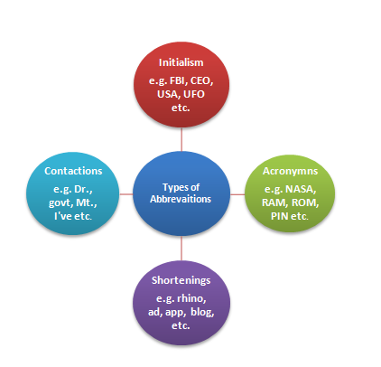

Slide 4
Latin-based Abbreviations
i.e. - id est (that is)
n.b. or NB - nota bene (“take notice” or "note well”)
p .s. - post scriptum (written after)
viz. - videlicet (namely)
et al. - et alia (and others)
ibid. - ibidem (in the same source)
CV - curriculum vitae (course of life)

Slide 5
BA - Bachelor of Arts
BS - Bachelor of Science
MA - Master of Arts
MSc- Master of Science
MBA - Master of Business Administration
MFA - Master of Fine Arts
PhD, Ph.D, DPhil - Doctor of Philosophy

Slide 6
Abbreviations Based on Time and Date
AM - ante meridiem (before noon)
PM - post meridiem (after noon)
AD - Anno Domini
BC - Before Christ
GMT - Greenwich Mean Time
UTC - Universal Time Coordinated (also referred to as Coordinated Universal Time)

Slide 7
Social Media and Online Abbreviations
AFAIK - as far as I know
BRB - be right back
IIRC - if I recall correctly
NP - no problem
YW - you’re welcome
DM - direct message
IMO - in my opinion

Slide 8
ETA – estimated time of arrival
FAQ – frequently asked questions.
FYI – for your information..
CC and BCC – CC means carbon copy and BCC means blind carbon copy.
RSVP – For the French répondez s’il vous plait (please reply).

Slide 9
VIP – very important person.
YOLO – you only live once.
Google
A googol is 1 followed by 100 zeros. The name "Google" being an accidental misspelling of "googol" by the company's founders.
Global Organization of Oriented Group Language of Earth.

Slide 10
Email – Electronic mail
Gmail - Google Mail.
Re: – Regarding
ESP : English for specific purposes.
YouTube” is said to be derived from “You” which means you (from the fact that the video came from you) and “Tube” means television (cathode ray tube).
TOEFL- (Test of English as a Foreign Language)
IELTS International English Language Testing System

Slide 11
PDF is Portable Document Format.
Wi-Fi is a short name for Wireless Fidelity". Wireless technology” suggests the absence of cables or wires for the transfer of signals and “fidelity” meaning lasting support
LASER stands for Light Amplification by Stimulated Emission of Radiation

Slide 12
References
https://www.grammar-monster.com/glossary/abbreviations.htm
https://www.toppr.com/guides/business-communication-and-ethics/essential-of-good-english/abbreviations/#What_is_an_Acronym
https://abbreviations.yourdictionary.com/articles/list-of-commonly-used-abbreviations.html

