Slide 1
Axiomatic System and Geometry 2022-2023

Slide 2
Lecture 1
Some Basic Information of Geometry with Figures
In its simplest form, geometry is the mathematical study of shapes and space. ... Before diving into two-dimensional and three-dimensional shapes, consider the basic geometric objects that create these shapes: points, lines, line segments, rays, and planes. A point is represented by a dot and shows a location in space.

Slide 3
1- point
6- parallel lines
7- perpendicular lines
2- horizontal line
8- angle BAC
B
A
C
3- vertical line
9- alternative angles:
Angles that are between parallel lines, but on opposite sides of a transversal
As angle1 and angle2
4- diagonal line
5- curve
1
2

Slide 4
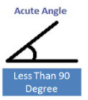
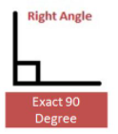
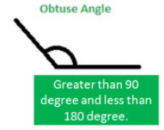
10- angle bisector:
Is the line that divides an angle into two equal parts.
12- right angle
Two perpendicular lines make four equal angles, so one of these angles is a right angle
90
x
x
13-
14-
11- vertical angles:
It consists of two equal angles of measure such as angle 1 and angle 2.
15-
2
1

Slide 5
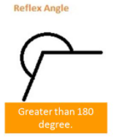
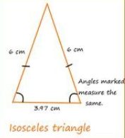
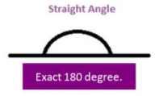
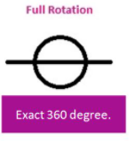
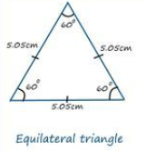
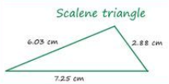
16-
17-
20-
18-
19-
21-

Slide 6
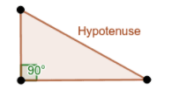
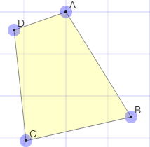
22-
25-
height
23-
Base
26- quadrilateral:
It is consists of 4 distinct point
A, B, C, D in the plane
24-

Slide 7
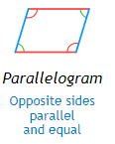
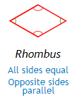
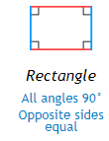
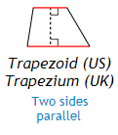
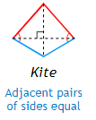
29-
30-
27-
28-
32-
31-

Slide 8
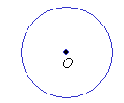
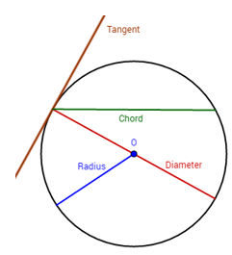
33-

Slide 9
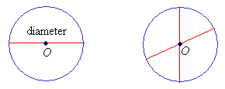
34-
35-

Slide 10
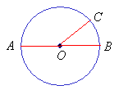
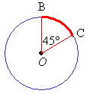
36-
37-

Slide 11
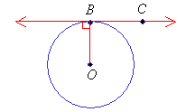
38-

Slide 12
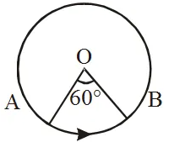
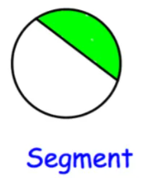
39-
40-

Slide 13
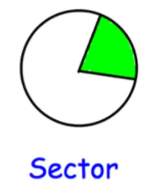
41-
42-

Slide 14
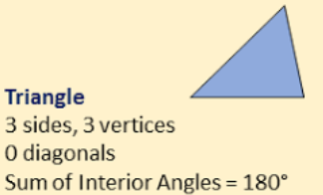
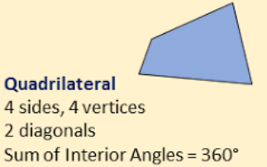
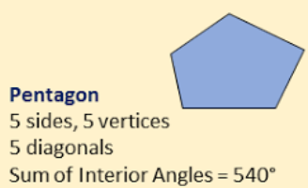
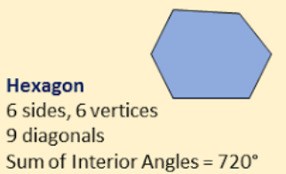
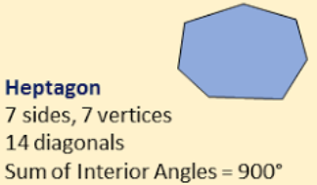
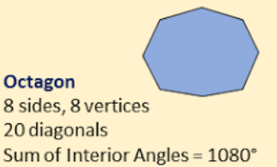
50-

Slide 15
