Slide 1
Axiomatic System and Geometry 2022-2023
Lecture 2
History of Geometry and Axiomatic System

Slide 2
The Babylonian’s Geometry: the Babylonians were more advanced than Egyptians in math, so many of their boards were giving algebra analysis for those problems that’s known as algebra equations now. 1) (a+b)(a+b) = a²+2ab+b² 2) (a+b)c = ac+bc 3) a(b-a) = ab-a² 4) a(b-c) = ab-ac 5) (a-b)² = a²-2ab+b² 6) (a+b)(a-b) = a²-b²

Slide 3
The Babylonian’s Geometry: 1) (a+b)(a+b) = a²+2ab+b²
a+b
a
b
A= ab
B= b²
b
A= ab
a+b
C= a²
a

Slide 5
Example#: undefined terms A1, A2 and the relation belong to Axiom1: there exist exactly 3 distinct A1’s in this system. Axiom2: two distinct A1’s belong to exactly one A2. Axiom3: not all A1’s belong to the same A2. Axiom4: any two distinct A2’s contain at least one A1 which belong to both.

Slide 6
Theorem1:A1-A2 two different A2’s there exist exactly one A1.
Theorem2:A1-A2 there are exactly three A2’s.
Theorem3:A1-A2 Each A2 has exactly two A1’s that belong to it.

Slide 9
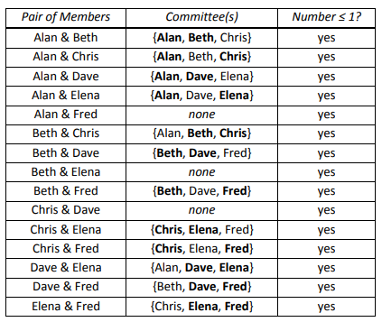
Therefore this axiomatic system is model
Because all axioms are true.

Slide 10
Example2: H.W by assigning A1 as book and A2 as horizontal shelve the example# is interpreted as following.
Does put into words in the following examples become a model?
Example1: by assigning A1 as person and A2 as committee the example# is interpreted as following.

Slide 11
Example3: H.W by assigning A1 as toy and A2 as child the example# is interpreted as following.
Example4: H.W by assigning A1 as point and A2 as line in the example# is interpreted as following.

