Slide 1
Calculus Lecture3
Absolute Value properties and solving equations involving absolute values, Greatest and least integer function

Slide 3
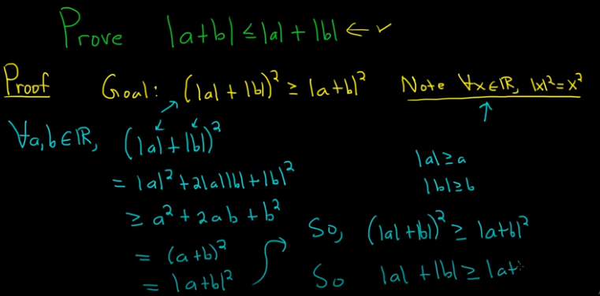

Slide 5
6. $\sqrt{a^{2}}=\left|a\right|$ for every real number a

Slide 7
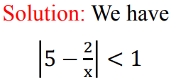

Slide 8
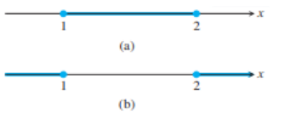

Slide 9
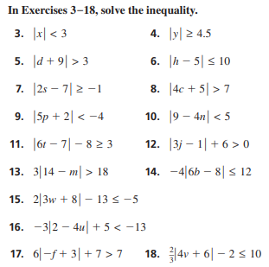
H.W

Slide 10
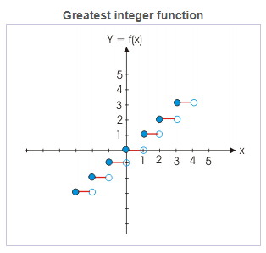

Slide 11
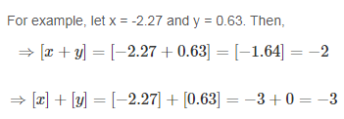

Slide 12
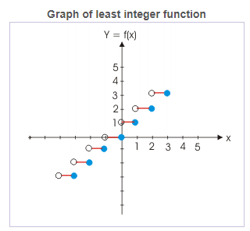
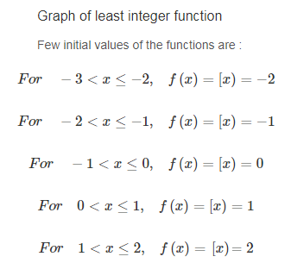

Slide 14
1.
2.
3.
4.
5.
6.
7.
8.
9.
H.W

Slide 15
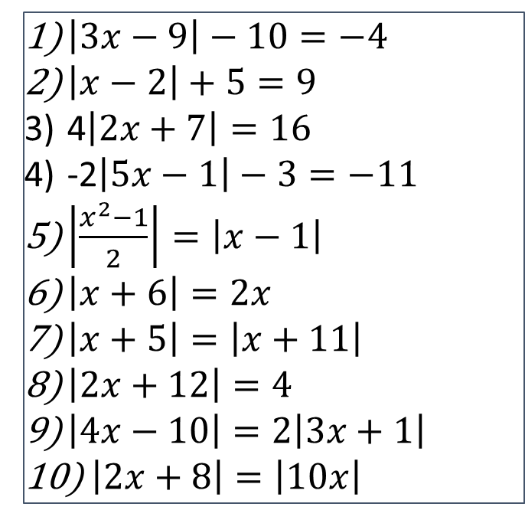
Ex1: Find domain from the following functions
Ex2: Solve the following functions and check your solution.
$$1) f\left(x\right)=\frac{1}{\sqrt{π−\left[x\right]}}$$
$\left|3x−9\right|−10=−4$
$\left|x−2\right|+5=9$
4$\left|2x+7\right|=16$
-2$\left|5x−1\right|−3=−11$
$\left|\frac{x^{2}−1}{2}\right|=\left|x−1\right|$
$\left|x+6\right|=2x$
$\left|x+5\right|=\left|x+11\right|$
$\left|2x+12\right|=4$
$\left|4x−10\right|=2\left|3x+1\right|$
$\left|2x+8\right|=\left|10x\right|$
2) $f\left(x\right)=\frac{1}{\left[x−2\right]}$
$$3) f\left(x\right)=\frac{2}{\left\lceil x\right\rceil }$$

