Slide 1
calculus
Lecture 4
One-to-One Functions ,Even and Odd Functions , Composite Functions

Slide 3
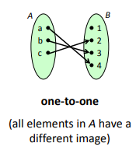
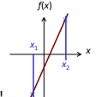
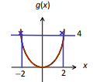
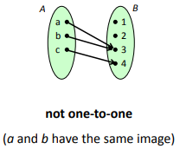

Slide 4
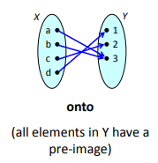
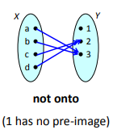

Slide 6
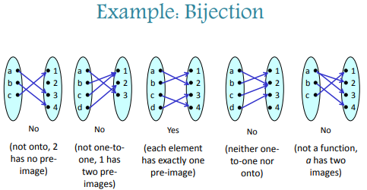

Slide 7
Are the following functions bijection? $$1) f:\left\{1,2,3,4\right\}→\left\{2,4,6,8\right\}, f\left(x\right)=2x \\ 2) g:\left\{x;x≥1\right\}→\left\{y;y≥0\right\}, g\left(x\right)=\frac{1}{x} \\ 3) h:R→R, h\left(x\right)=(x−1)^{2} \\ 4) k:R→R, k\left(x\right)=x^{3} \\ 5) w:\left[1,2\right)→\left[0,1\right], w\left(x\right)=\left[x\right] \\ 6) u:\left(0,1\right]→\left\{1\right\}, u\left(x\right)=[x)$$

Slide 8
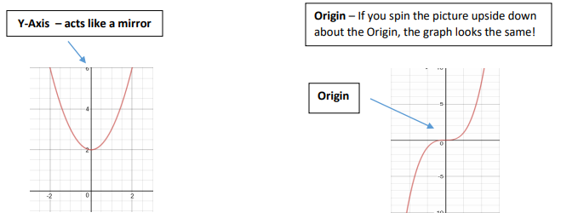

Slide 10
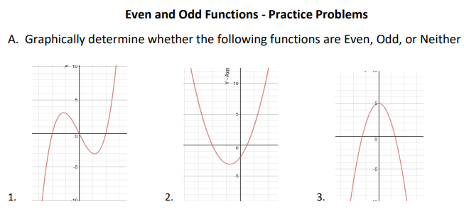
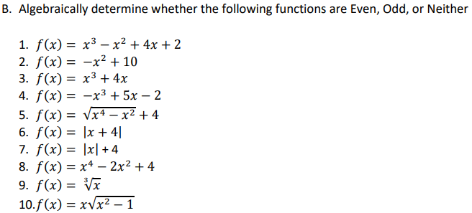
H.W

Slide 12
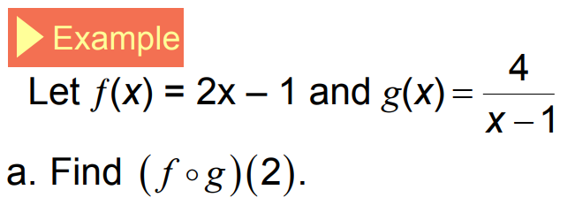
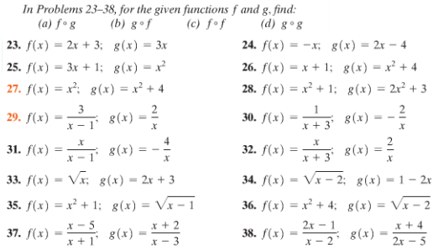
H.W

