Slide 1
Calculus
Limit (by definition and rules), one sided limits

Slide 5
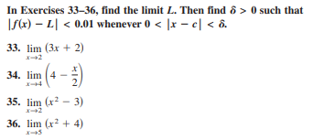
Example: Show that $\lim_{x→2}\left(x^{2}+3x\right)=10$
H.W

Slide 7
H.W
Where 1) c= 2 2) c= -1
4.

Slide 8
Example: find
H.W
1.
2.

Slide 9
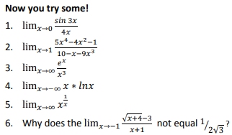
H.W

Slide 10
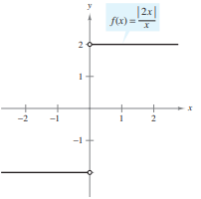
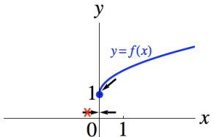

Slide 11
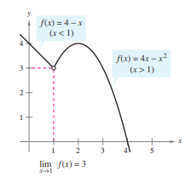
H.W

Slide 12
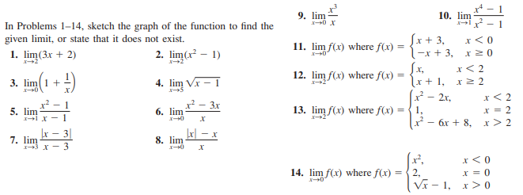
H.W

Slide 13
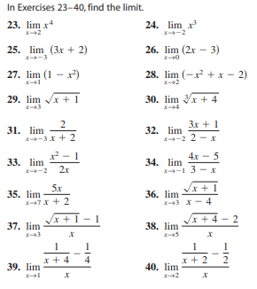
H.W

Slide 14
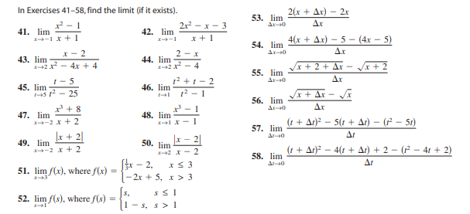
H.W

