Slide 1
calculus
Lecture 6: sandwich theorem and limits of special Trigonometric functions

Slide 2
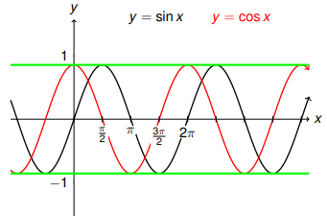
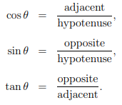
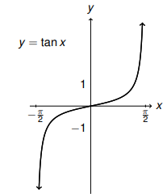
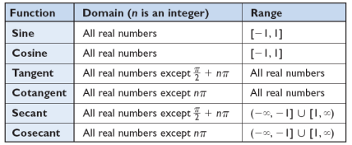
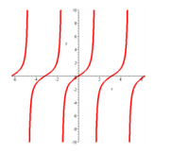
Trigonometric functions

Slide 3
$let f\left(x\right)=x^{2}$ $and h\left(x\right)=2x find limit of g\left(x\right) where x → 2$

Slide 4
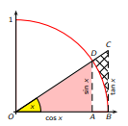

Slide 5
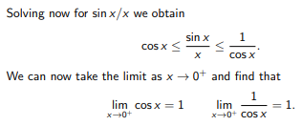

Slide 6
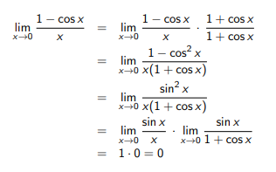
1)
2)
3)
4)

Slide 7
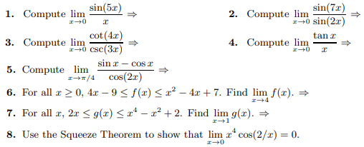
H.W
Notes:
week2

Slide 8
