Slide 1
Calculus
Lecture 7: Limits at infinity, infinite limit

Slide 2
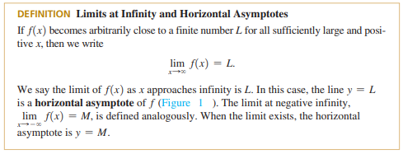
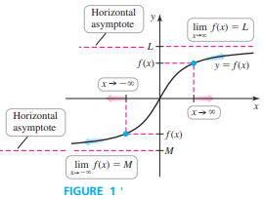

Slide 3
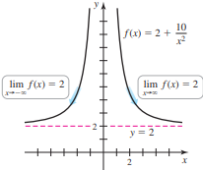
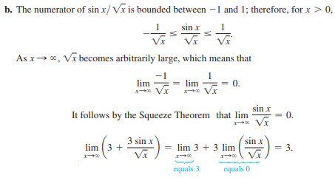
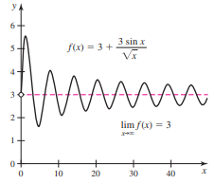

Slide 4
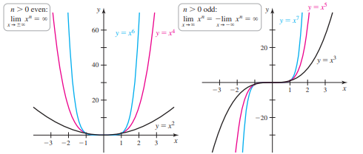

Slide 5
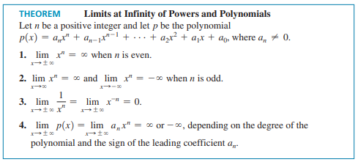

Slide 8
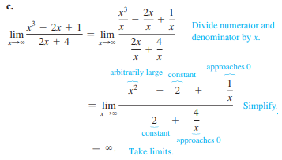
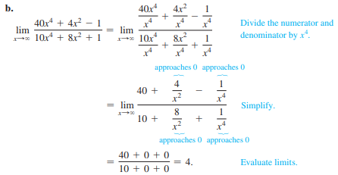

Slide 9
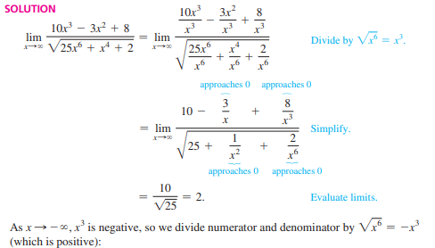
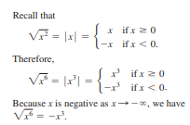

Slide 10
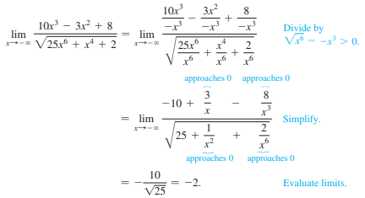
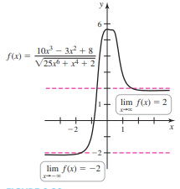

Slide 11
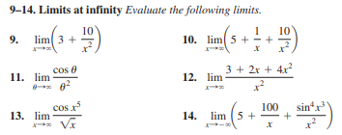
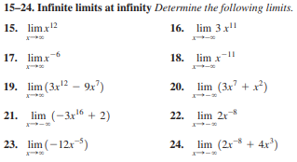
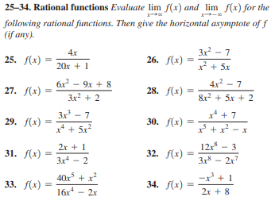
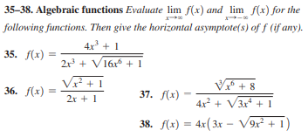
H.W

Slide 12
Group A math
Find the limit without using L’Hopital’s rule
$$\lim_{x→0}{\frac{\tan^{2}{(6x)}}{{\cos{(x}) tan}^{2}(7x)}}$$

Slide 13
Group B math
Find the limit without using L’Hopital’s rule
$$\lim_{x→0}{\frac{1−\sec^{2}{(2x)}}{x^{2}}}$$

Slide 14
Group A science
Find the limit without using L’Hopital’s rule
$$\lim_{x→0}{\frac{\tan^{2}{(2x)}}{{3x}^{2}}}$$

Slide 15
Group B science
Find the limit without using L’Hopital’s rule
$$\lim_{x→0}{\frac{\sin^{2}{(x)}}{ x\left(1+\cos\left(x\right)\right) }}$$

Slide 16
Group B science
Use the Squeeze theorem to find the limit
$$\lim_{x→0}{x^{4}\cos{(\frac{2}{x})}}$$

