Slide 1
FINITE Lecture 1 2022-2023

Slide 4
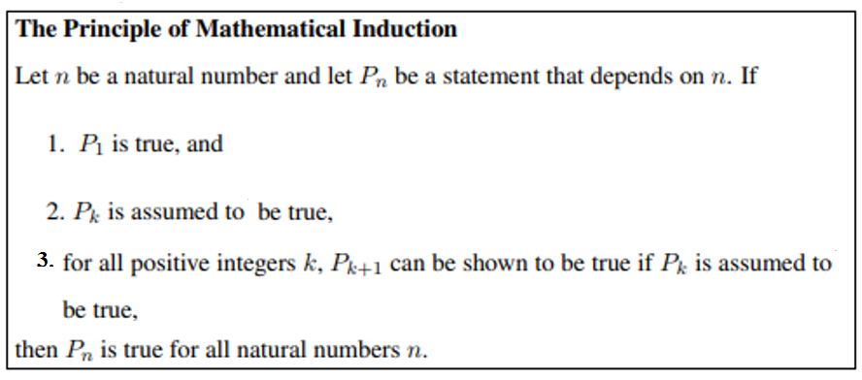

Slide 5
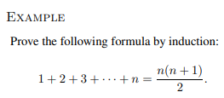
or

Slide 7
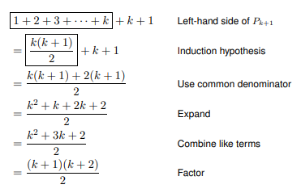

Slide 9
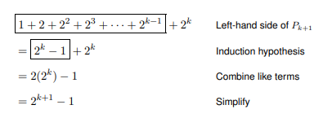

Slide 11
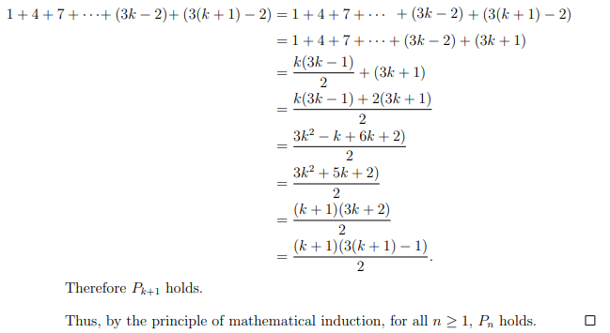

Slide 14
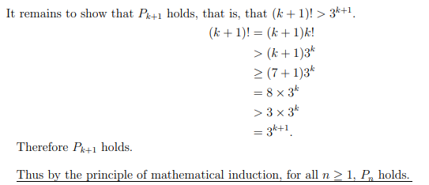

Slide 16
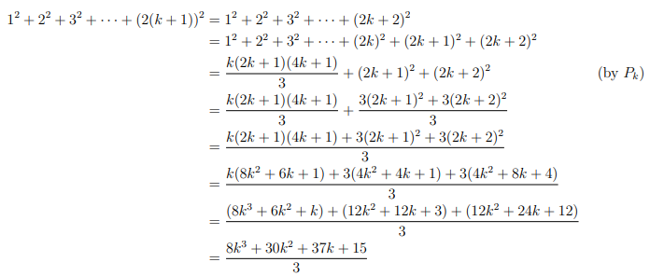

Slide 17
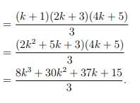

Slide 18
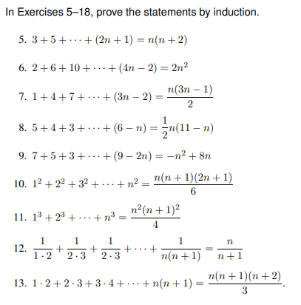
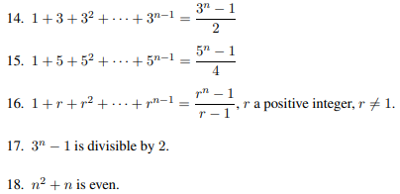
H.W

Slide 20
Prove that by Mathematical Induction, where n is any positive integer numbers.
$$A) 1+3+3^{2}+3^{3}+…+3^{n−1}=\frac{3^{n}−1}{2}$$
$$B) 1+5+5^{2}+5^{3}+…+5^{n−1}=\frac{5^{n}−1}{4}$$

