Slide 1
De Mover's Theorem and root finding
Lecture 6

Slide 3
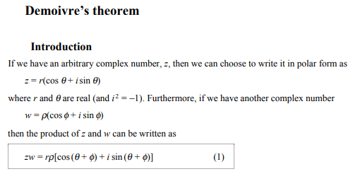

Slide 5
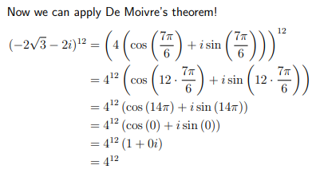

Slide 8
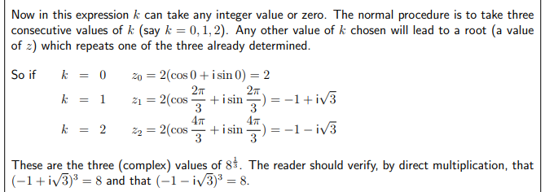

Slide 10
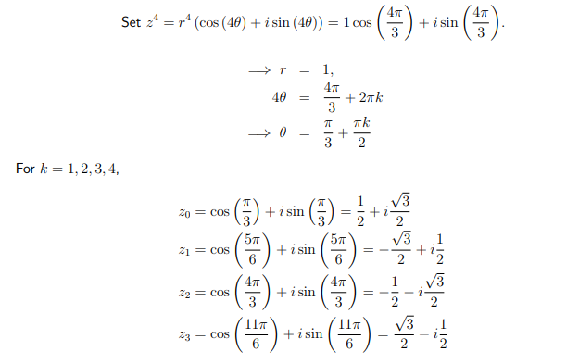
0,1,2,3

Slide 13
