Slide 1
Argument Of a complex number
Lecture 5

Slide 3
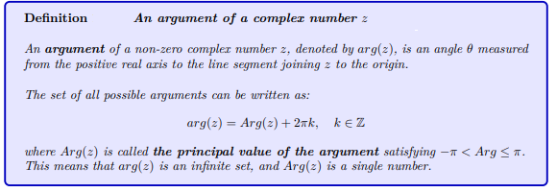

Slide 4
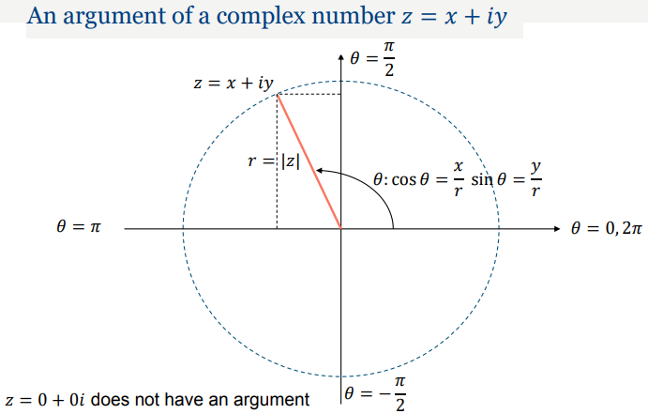

Slide 10
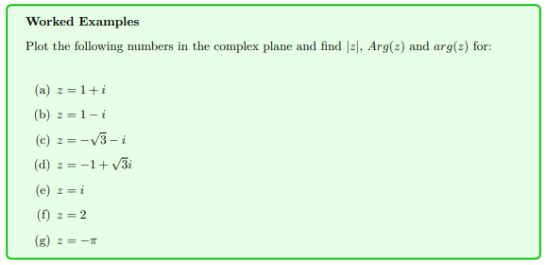

Slide 11
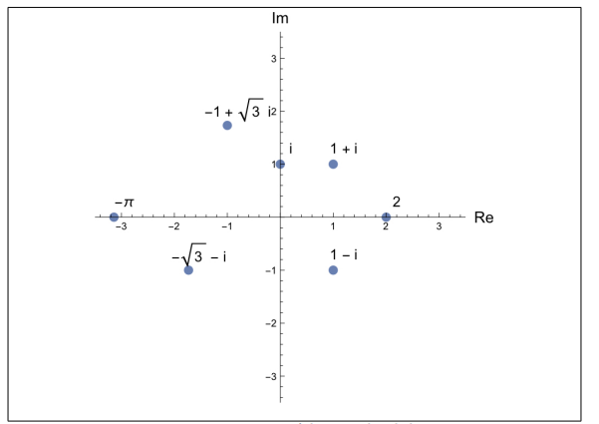

Slide 12
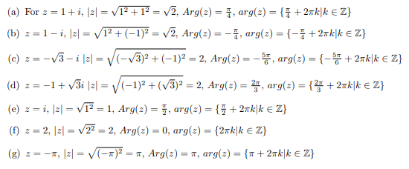

Slide 13
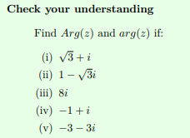
H.W

Slide 14
NOTE: if $z=\left|z\right|(\cos{θ}+i \sin{θ})$ is called Polar form

Slide 15
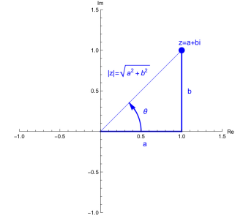
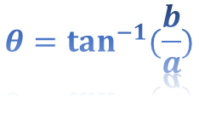
$$θ=\tan^{−1}{(\frac{b}{a})}$$

Slide 16
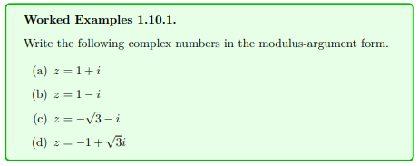
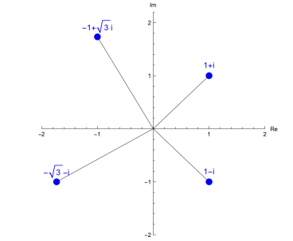
or Polar form

Slide 18
Let $Z=a+bi$show that
$$\left|Z^{2}\right|={\left|\overline{Z}\right|}^{2}$$

