Slide 1
Calculus
Lecture 9: Tangent and derivative, slope and tangent line

Slide 2
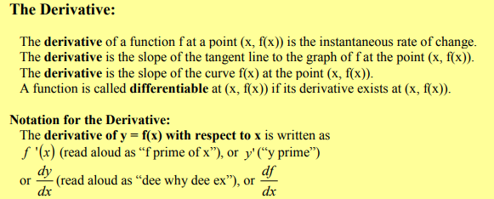
DEFINITION
A function $f$is said to be differentiable at $x$if $\lim_{h→0}{\frac{f\left(x+h\right)−f(x)}{h}}$ this limit exists, it is called the derivative of $f$at $x$and is denoted by $\acute{f(x})$

Slide 3
EXAMPLES: Find the derivative of f(x) using the definition we have.
1) $f\left(x\right)=\sqrt{x}$
2) $f\left(x\right)=x^{2}$
3) $f\left(x\right)=\frac{1}{x}$
4) $f\left(x\right)=3$
5) $f\left(x\right)=\left\{\begin{matrix}x^{2} if x≤1 \\ 2x−1 if x>1\end{matrix}\right.$ find $\acute{f(−}3) and \acute{f(1})$
6) $f\left(x\right)=\sin{x}$
7) $f\left(x\right)=e^{2x}$
8) $f\left(x\right)=\left\{\begin{matrix}4x if x<1 \\ 4x−1 if x≥1\end{matrix}\right.$
Example 9: find $A$and $B$given that the function is differentiable at $x=2$,
where $f\left(x\right)=\left\{\begin{matrix}x^{2}−2 if x≤2 \\ Bx^{2}+Ax if x>2\end{matrix}\right.$

Slide 4
Example 10: find A and B given that the function is differentiable at x=1,
where $f\left(x\right)=\left\{\begin{matrix}x^{3} if x≤1 \\ Ax+B if x>1\end{matrix}\right.$
Example 11: show that $f\left(x\right)=\left|x\right|$ is not differentiable at x=0
Example 12: show that $f\left(x\right)=\left\{\begin{matrix}x^{2} if x≤1 \\ \frac{1}{2}x+\frac{1}{2} if x>1\end{matrix}\right.$ is not differentiable at x=1
Tangent line
If $f$is differentiable at $c$, the line passes through the point $(c,f(c))$ with slope $\acute{f(c} )$ is the tangent line at that point. As an equation for this line we can write
$y−f\left(c\right)=\acute{f(c})(x−c)$
Example 1: let $f\left(x\right)=\sqrt{x}$ write an equation for the tangent line at the point (4,2).

Slide 5
Examples: write an equation for the tangent line at the point $(c, f(c ))$.
1) $f\left(x\right)=5−x^{3}$ at c=2 2) $f\left(x\right)=\frac{1}{x^{2}}$ at c=-2 3) $f\left(x\right)=−\sqrt{x}$ at c=4
The Slope
Ex: find the slope 1) $f\left(x\right)=\sqrt[3]{3−x}$ at x=1, 2) $f\left(x\right)=4x^{3}+2x^{2}−5x+6$ at x=2

Slide 6
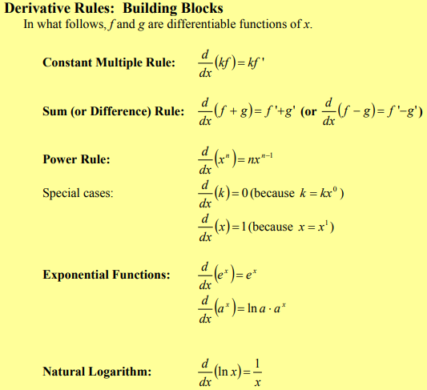
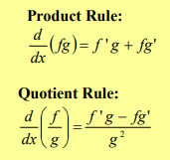

Slide 7
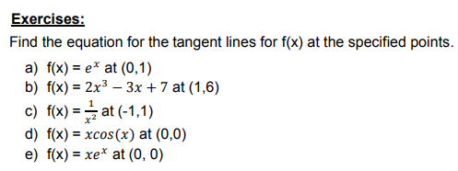
H.W

Slide 8
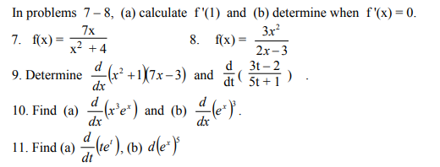
H.W

Slide 9
A

Slide 10
B
x

