Slide 1
Finite Mathematics
Lecture 7: Polynomial

Slide 4
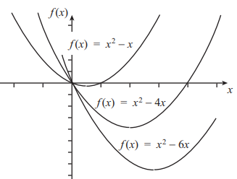
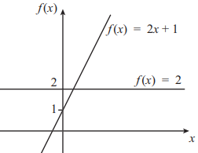
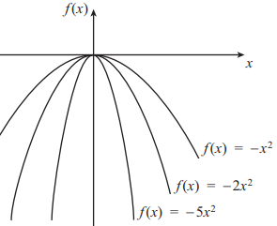
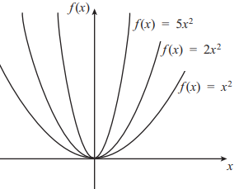
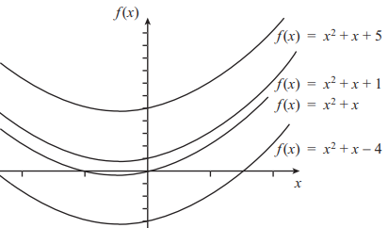
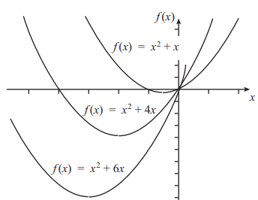

Slide 5
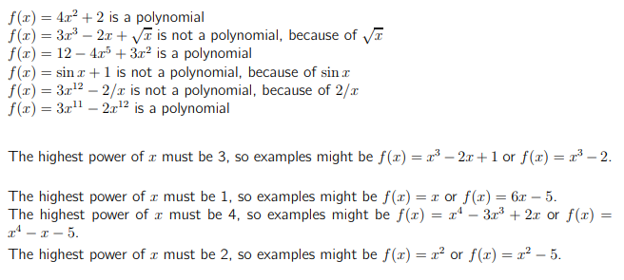

Slide 8
Polynomials: we mean an expression of the form $f\left(x\right)=a_{m}x^{m}+a_{m−1}x^{m−1}+…+a_{2}x^{2}+a_{1}x^{1}+a_{0}, a_{i}∈R.$The symbols $x, x^{2},…, x^{m}$ here are not unknowns or variables for some $m∈Z^{+}∪\left\{0\right\}$ and $a_{m}≠0$. Multiplication of polynomials: if $f\left(x\right)=a_{m}x^{m}+a_{m−1}x^{m−1}+…+a_{2}x^{2}+a_{1}x^{1}+a_{0}$, $a_{i}∈R$ and g$\left(x\right)=b_{n}x^{n}+b_{n−1}x^{n−1}+…+b_{2}x^{2}+b_{1}x^{1}+b_{0}, b_{j}∈R$ also $f\left(x\right).g\left(x\right)=c_{n+m}x^{n+m}+…+c_{2}x^{2}+c_{1}x^{1}+c_{0}$ where $c_{k}=\sum_{i+j=k}{a_{i}b_{j}}$ $$c_{0}=a_{0}b_{0} \\ c_{1}=a_{1}b_{0}+a_{0}b_{1} \\ c_{2}=a_{2}b_{0}+a_{0}b_{2}+a_{1}b_{1} \\ c_{3}=a_{3}b_{0}+a_{0}b_{3}+a_{1}b_{2}+a_{2}b_{1} \\ c_{4}=a_{4}b_{0}+a_{0}b_{4}+a_{3}b_{1}+a_{1}b_{3}+a_{2}b_{2} \\ c_{5}=a_{5}b_{0}+a_{0}b_{5}+a_{4}b_{1}+a_{1}b_{4}+a_{3}b_{2}+a_{2}b_{3}$$ and so on

Slide 9
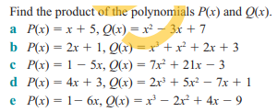

Slide 11
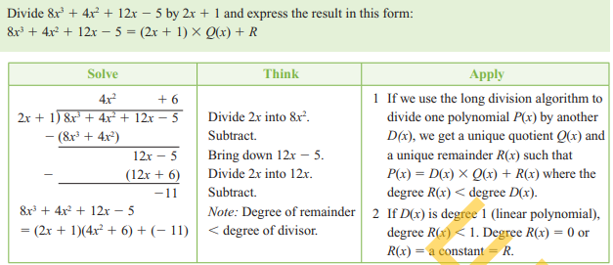

Slide 12
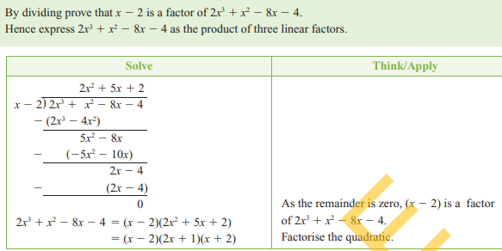

Slide 14
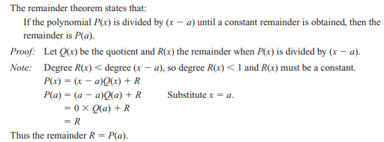

Slide 15
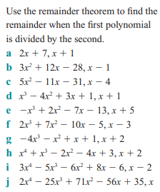

Slide 18
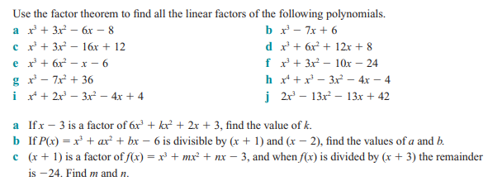

Slide 19
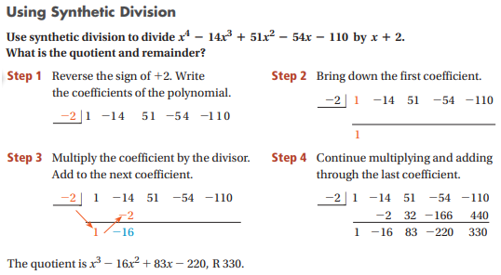

Slide 20
If we divide the polynomial P(x) by the polynomial g(x) and the remainder R(x) is equal to zero, then the polynomial g(x) is the greatest common factor of P(x).
Find GCD $f\left(x\right)={x^{5}−x}^{4}−{2x}^{3}+{2x}^{2}+x−1 ,$
$f1\left(x\right)={{5x}^{4}−4x}^{3}−{6x}^{2}+4x$+1
How find GCD, as following :-

