Slide 1
Finite Mathematics
Lecture 8: Solve the polynomial of degree 3

Slide 4
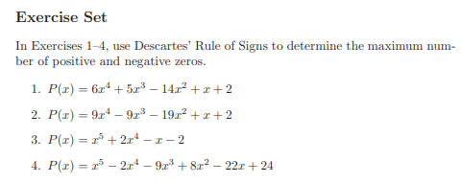

Slide 6
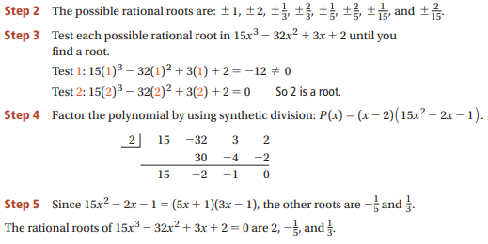

Slide 7
$$f\left(x\right)=x^{3}+x+2$$

Slide 9
solve equation of degree three by Cardan method
$$x^{3}+bx+c=0……(1)$$
$$let x=m+n where m and n are roots$$
$$x^{3}=(m+n)^{3}=m^{3}+n^{3}+3nm^{2}+3mn^{2}$$
$x^{3}=m^{3}+n^{3}+3nm(m+n$)
$$x^{3}=m^{3}+n^{3}+3nmx →x^{3}−3mnx−\left(m^{3}+n^{3}\right)=0….(2)$$
By (1) and (2) we get $−3mn=b →mn=\frac{−b}{3} →m^{3}n^{3}=−\frac{b^{3}}{27} and −\left(m^{3}+n^{3}\right)=c$
Let's be a quadratic equation whose roots are $m^{3}, n^{3}$
$h^{2}−\left(m^{3}+n^{3}\right)h+(m^{3}n^{3})=0$ …….(*)

Slide 10
We solve equation ( *) get $h_{1}, h_{2}$
$h_{1}=m^{3} and h_{1}=n^{3}$ after that get m and n so the roots are $x_{1}=m+n$
$$x_{2}=ωm+ω^{2}n$$
$$x_{3}=ωn+ω^{2}m where ω=\frac{−1}{2}+\frac{\sqrt{3}i}{2}, ω^{2}=\frac{−1}{2}−\frac{\sqrt{3}i}{2}$$

Slide 11
solve equation of degree three by Cardan method

Slide 18
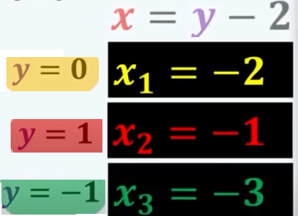

Slide 19
What does Descarte’s Rule of signs tell you about the roots of f(x)?
$A: f\left(x\right)=8x^{3}+2x^{2}−5x+1 , B: f\left(x\right)=10x^{3}−7x^{2}+x−10$

