Slide 1
Introduction to Algebra
Lecture 1: Matrix & Matrix Operation

Slide 3
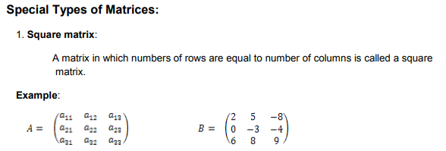

Slide 4
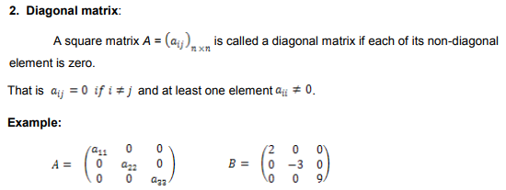

Slide 11
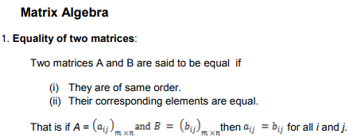

Slide 13
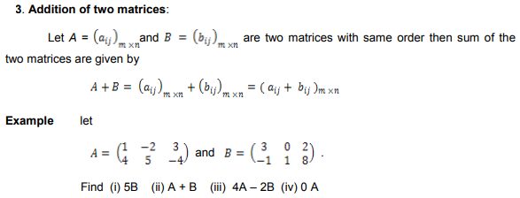
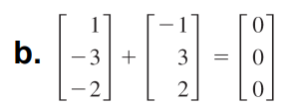

Slide 14
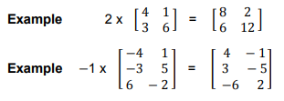

Slide 16
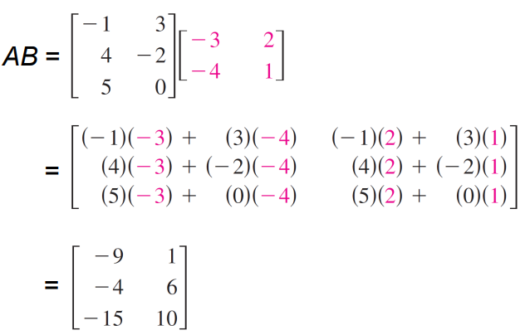

Slide 17
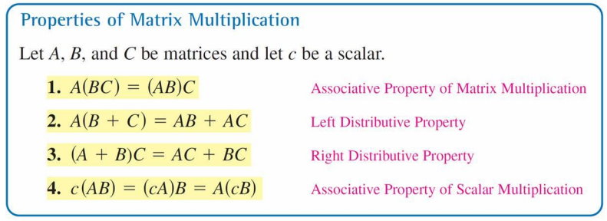

Slide 18
$$let A=\left[\begin{matrix}2 & −1 \\ 4 & 3 \\ −3 & 0\end{matrix}\right] and B=\left[\begin{matrix}7 & −2 \\ 5 & 1\end{matrix}\begin{matrix} −3 \\ 4\end{matrix}\right]$$
$find AB$
$find BA$

