Slide 1
Introduction to Algebra
Lecture 2: Transpose & Determinant

Slide 3
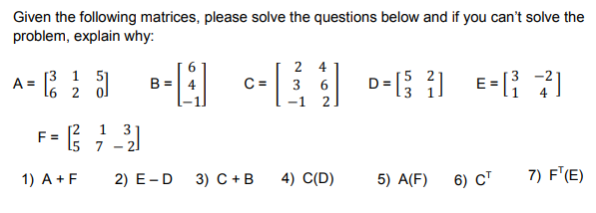
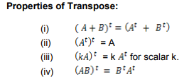

Slide 7
$$For all i and j, except i=j$$

Slide 8
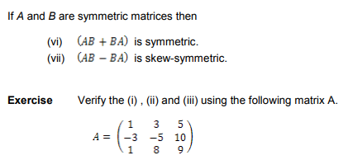

Slide 9
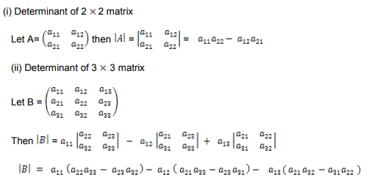

Slide 11
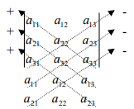
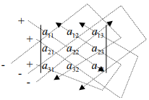

Slide 13
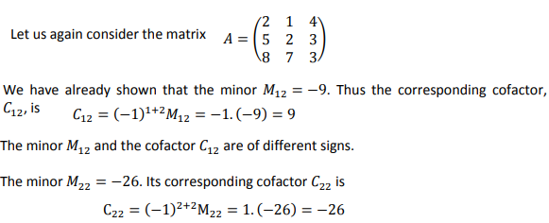

Slide 19
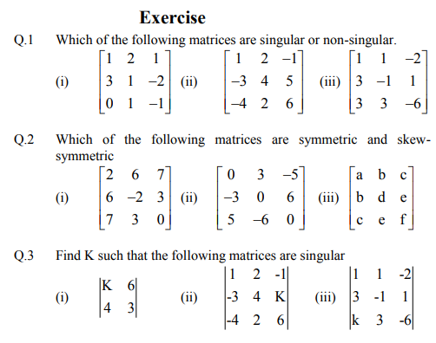

Slide 20
$$let A=\left(\begin{matrix}8 & −2 & 7 \\ −2 & −9 & 3 \\ 7 & 3 & 5\end{matrix}\right) , find A^{T} and show that A^{2} is symmetric matrix$$
$$let B=\left(\begin{matrix}−2 & 3 & 5 \\ −3 & 1 & 4 \\ −5 & −4 & 6\end{matrix}\right) , find B^{T} and show that B^{2} is symmetric matrix$$

