Slide 1
Statistical Inference
2022-2023 first semester

Slide 2
Some definition of statistic Inference Some Parametric distribution.

Slide 4
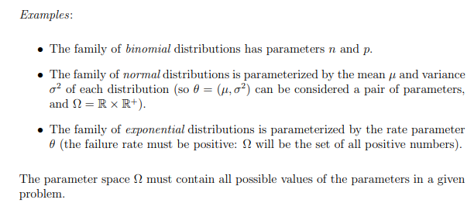

Slide 5
Random Variable:
Is a real number function whose value is determined by the out come of random trials.
Discrete Random Variable:
A random variable whose space is a composed of countable number of point is called a random variable of discrete type.
Continuous Random Variable:
A random variable whose space is an interval is called a random variable of continuous type.

Slide 6
Probability density function:- (p.d.f.) p.d.f. is a mathematical function of a r.v. of continuous type satisfies the following: 1) $f\left(x\right)>0, x∈ R$ 2) $\int_{∀x}{f(x)dx}=1$ Probability mass function:- (p.m.f.) p.d.f. is a mathematical function of a r.v. of discrete type satisfies the following: 1) $f\left(x\right)>0 , x ∈R$ 2) $\sum_{∀x}{f(x)=}1$

Slide 7
Probability Function:-
Is real valued function defined on F into [0,1] is called a probability function if following satisfied:-
P(A)≥0 Ʉ A ϵ F
P(S)=1 and P(φ)=0
P(AUB)=P(A)+P(B) if A∩B= φ
Distributive Function:- The distributive function is defined by
$F\left(x\right)=P\left[X≤x\right]=\int_{−∞}^{x}{f\left(u\right)du}$
$f(x)=\frac{d}{dx}F(x)$

Slide 8
Mathematical Expectation:- let x be any random variable (r.v.) and u(x) be any function of x where x has probability distribution function (p.d.f.) then the mathematical expectation of u(x) is denoted E(u(x)) and given by:- $$E\left(u\left(x\right)\right)=\sum_{∀x}{u\left(x\right) P\left[X=x\right] discrete}$$ $= \int_{∀x}{u\left(x\right) f\left(x\right)dx continous}$

Slide 9
Bivariate and multivariate random variables:- let X and Y be two functions defined on Discrete or Continuous probability space, let R denoted the corresponding two dimensional space of X and Y. The two random variables of the discrete or continuous type, the probability that X=x and Y=y is denoted by f(x,y)=P[X=x,Y=y], the function is called the Joint p.d.f. of x and y has the following properties:- 1) $0≤ f(x,y) ≤1$ 2) $\sum{\sum{f\left(x,y\right)=1}} for discrete r.v.$ $\iint{f\left(x,y\right)dxdy=1} for continuous r.v.$ 3) $P\left(\left(x,y\right)∈A\right)=\sum{\sum_{(x,y)∈A}{f\left(x,y\right) discrete r.v}}$ =$\iint_{(x,y)∈A}{f\left(x,y\right)dxdy} continuous r.v.$ Where A is a subset of the space R.

Slide 10
Definition:- Let X and Y have Joint p.d.f. with space R. The p.d.f. of X alone is called the Marginal p.d.f. of X, is denoted by:- $$f_{1}\left(x\right)=\sum_{y}{f(x,y)} , x∈R discrete \\ f_{1}\left(x\right)=\int_{y}{f\left(x,y\right)dy}, x∈R continuous$$

Slide 11
and the Marginal p.d.f. of Y is denoted by:-
$$f_{2}\left(y\right)=\sum_{x}{f(x,y)}, y∈R discrete$$
$$f_{2}\left(y\right)=\int_{x}{f\left(x,y\right)dx}, y∈R continuous$$
NOTE: The random variables x and y are independent iff f(x,y)=f(x) f(y)

Slide 12
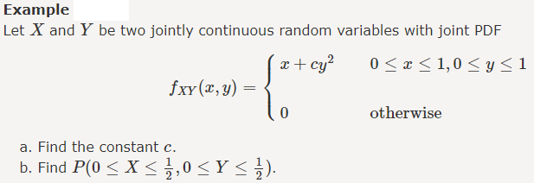
Definition:- The Joint p.d.f. of the n random variables x₁,x₂,…,x_{n} is defined by f(x₁,x₂,…,x_{n})=P(X₁=x₁,X₂=x₂,…,X_{n}=x_{n}). And the Marginal p.d.f. of one of r.v. say x_{n} is:- $f_{n}{(x}_{n})=\sum_{x_{1}}{\sum_{x_{2}}{…\sum_{x_{n−1}}{f(x_{1},x_{2},…,x_{n−1})}}}$ discrete $f_{n}{(x}_{n})=\int_{x_{1}}{\int_{x_{2}}{…\int_{x_{n−1}}{f\left(x_{1},x_{2},…,x_{n−1}\right)dx_{n−1}…dx_{2}dx_{1}}}}$ cont.

Slide 13
Definition:- The Conditional p.d.f. of X given that Y=y is defined by $$g\left(X/Y=y\right)=\frac{f(x,y)}{f(y)}; f\left(y\right)>0$$ and the Conditional of Y given that X=x is defined by $$h($$
$$h\left(Y/{X=x}\right)=\frac{f(x,y)}{f(x)}; f\left(x\right)>0$$

Slide 14
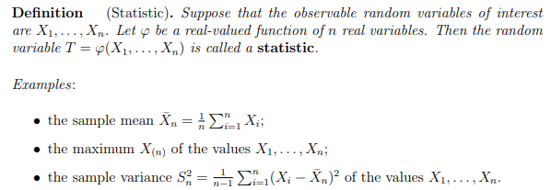

Slide 15
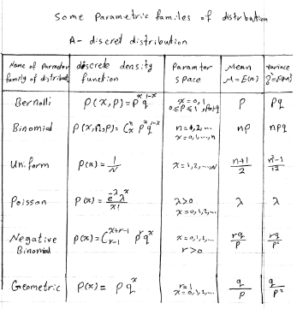
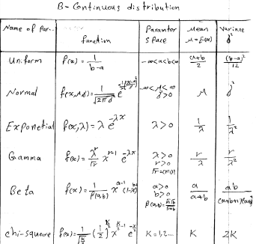
Tables of distributions

Slide 16
Example: two dice are throne , let X= the absolute difference between the two number appear on the two dice. Y= the number show on the first dice, find the joint p.d.f. for x and y. solution: f(x,y)=1/6 , x=0,1,2,3,4,5 ; y=1,2,3,4,5,6

Slide 17
Example: A box contains 3 ball numbers 1,2,3 we select 2 balls at random, 1) with replacement then find the probabilities. 2) without replacement then find the probabilities. Solution: let x=the number of the first selected y= the number of the second selected 1) $f(x)=\left\{\frac{1}{9} where x=1,2,3 y=1,2,3\right.$ 2) $f\left(x\right)=\left\{\begin{matrix}\frac{1}{6} if x≠y \\ 0 if x=y\end{matrix}\right. x=1,2,3 y=1,2,3$

Slide 18
Example: A box contains 6 white, 4 red and 5 green balls, we chose 3 balls at random find the probability of 3 balls. H.W

Slide 19
Example: A box contain 20 Christmas tree light bulbs of which 5 are red, 10 are blue and 5 are white. A sample of 5 bulbs is drawn randomly and let x represent the number of red bulbs and y the number of blue bulbs drawn, we obtain the joint p.d.f. of x and y the marginal p.d.f. of y and then the conditional distribution of x given Y=y. Solution: $f\left(x,y\right)=\frac{C_{x}^{5}{ C}_{y}^{10} C_{5−x−y}^{5}}{C_{5}^{20}}$ $$f\left(y\right)=\sum_{x}{f(x,y)}=\sum_{x=0}^{5−y}{\frac{C_{x}^{5} C_{y}^{10} C_{5−x−y}^{5}}{C_{5}^{20}}}=\frac{C_{5−y}^{10}{ C}_{y}^{10}}{C_{5}^{20}}$$

Slide 20
$$0≤y≤5−x \\ g(x/{y)=\frac{f(x,y)}{f(y)}=\frac{{C_{x}^{5} C_{y}^{10} C_{5−x−y}^{5}}/{C_{5}^{20}}}{{C_{5−y}^{10} C_{y}^{10}}/{C_{5}^{20}}}} \\ =\frac{C_{x}^{5} C_{5−x−y}^{5}}{C_{5−y}^{10}} 0≤x+y≤5$$

Slide 21
Example: let x,y be two cont. r.v. having joint p.d.f. defined by $$f\left(x,y\right)=\left\{\begin{matrix}2 0<x<y<1 \\ 0 o.w.\end{matrix}\right.$$ 1) find the marginal of x , y respectively. 2) find the conditional p.d.f. of h₁(x/y), h₂(y/x). 3) find E(x/y) and Var(x/y).

Slide 22
Example: the joint p.d.f. of two r.v. is given by $$f\left(x,y\right)=\frac{1}{2π\sqrt{1−ρ^{2}}}e^{\frac{−(x^{2}−2ρxy+y^{2})}{2(1−ρ^{2})}} \\ −∞<y<∞ , −∞<x<∞, \left|ρ\right|≤1$$ find the marginal distribution of x.

Slide 23
Example: let $x\sim p(λ)$ and the conditional distribution of y given X=x is b(n,p), find the distribution of y.

