Slide 1
Statistical Inference
2022-2023 Lecture 3

Slide 2
Order Statistics let $x_{1},x_{2},…,x_{n}$ be identical independent distribution with p.d.f. $f\left(x,θ\right), θεΩ and a<x_{i}<b$ for i=1,2,…,n defined $$y_{1}=smallest (x_{1},…,x_{n}) \\ y_{2}=second smallest (x_{1},…,x_{n}) \\ y_{j}=j^{th}smallest (x_{1},…,x_{n}) \\ y_{n}=largest of(x_{1},…,x_{n})$$ the order values $y_{1}≤y_{2}≤y_{3}≤…≤y_{n}$ are know as the order statistics.

Slide 3
1) The joint p.d.f. of $y_{1},y_{2},…,y_{n}$ is given by $g\left(y_{1},y_{2},…,y_{n}\right)=\left\{\begin{aligned}n!f\left(y_{1}\right)f\left(y_{2}\right)…f\left(y_{n}\right) a≤y_{1}≤y_{2}≤…≤y_{n}≤b \\ 0 other wise\end{aligned}\right.$

Slide 4
2) The distribution function of the j^{th} order statistics y can be determinate as $$g_{j}\left(y_{j}\right)=\begin{matrix}\frac{n!}{\left(j−1\right)!\left(n−j\right)!}[F(y_{j})^{j−1}][1−F\left(y_{j}\right)]^{n−j}f\left(y_{j}\right) , a≤y_{j}≤b \\ 0 other wise\end{matrix}$$
As special cases we may calculate the distribution function of the smallest observation of $x_{1},x_{2},…,x_{n}$
$$g_{1}\left(y_{1}\right)=\left\{\begin{aligned}n(1−F\left(y_{1}\right))^{n−1}f\left(y_{1}\right) , a≤y_{1}≤b \\ 0 other wise\end{aligned}\right.$$
And the distribution of the largest observation of $x_{1},x_{2},…,x_{n}$
$$g_{n}\left(y_{n}\right)=\left\{\begin{aligned}n(F\left(y_{n}\right))^{n−1}f\left(y_{n}\right) , a≤y_{n}≤b \\ 0 other wise\end{aligned}\right.$$

Slide 5
3) The joint p.d.f. of $y_{i} and y_{j}$ is given by $$g_{ij}\left(y_{i},y_{j}\right)=\left\{\begin{aligned}\frac{n!}{\left(i−1\right)!\left(j−i−1\right)!\left(n−j\right)!}(F\left(y_{i}\right))^{i−1}[F\left(y_{j}\right)−F(y_{i})]^{j−i−1}[1−F\left(y_{j}\right)]^{n−j}f\left(y_{i}\right)f(y_{j}) \\ 0 other wise\end{aligned}\right.$$
$$a≤y_{i}≤y_{j}≤b$$

Slide 6
Example: let $y_{1}<y_{2}<…<y_{n}$ be the order statistics of random sample of size n from a distribution with p.d.f. f(x)=1, 0<x<1 find the k^{th} order statistics distribution and determine what is the name?

Slide 7
Example: let $x_{1},x_{2},…,x_{5}$ be a r.s. of size 5 with p.d.f. $f\left(x\right)=e^{−x}, x>0$ , let $z_{1}=y_{2} and z_{2}=y_{4}−y_{2}$ are order statistics, find $h(z_{1},z_{2})$.

Slide 8
Example: let $x_{1},x_{2},…,x_{5}$ be a r.s. of size 5 with p.d.f. ${β(2,1)}_{}$ find the 1) p.d.f. of largest value 2) p.d.f. of smallest value 3) j.p.d.f of ( $y_{2} ,y_{4})$.

Slide 10
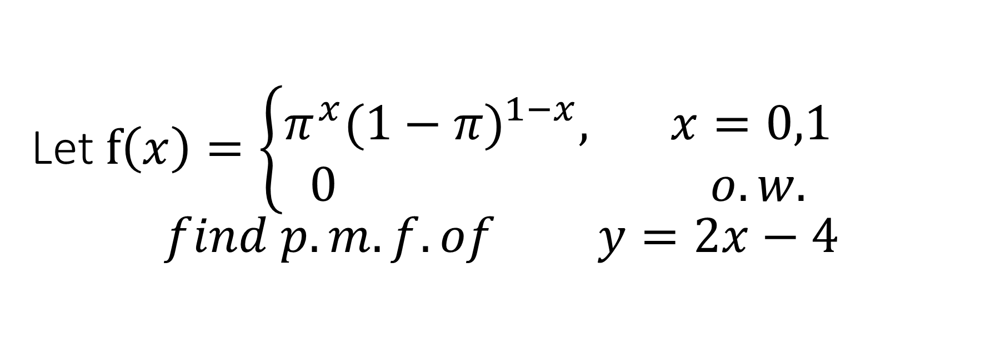
Let $f\left(x\right)=\left\{\begin{aligned}π^{x}{(1−π)}^{1−x}, x=0,1 \\ 0 o.w.\end{aligned}\right.$ $$find p.m.f. of y=2x−4$$

