Slide 1
Statistical Inference
Lecture 7

Slide 2
Consistency:- let $x_{1},x_{2},…,x_{n}$ be a random sample from a population with p.d.f. f(x), the estimator $\hat{θ}$ is called a consistent estimator for the parameter $θ$ if and only if which implies two conditions:- 1) $\lim_{n→∞}{E\left(\hat{θ}\right)=θ} , 2) \lim_{n→∞}{V\left(\hat{θ}\right)=0}$

Slide 3
Example: let $x_{1},x_{2},…,x_{n}$ be a r.s.s.n from Bernoulli distribution with parameter $θ, is \overline{X}$ consistent estimator for $θ$.

Slide 4

Example: show that $\hat{θ}={\overline{X}}^{2}$is a consistent estimator for $θ^{2} of N(θ, σ^{2})$

Slide 5
Example: show that $\hat{θ}=\overline{X}$ is consistent estimator for $θ$ of $Po(θ$).

Slide 6
Example: is ${y_{n}=max⁡(x}_{1},x_{2},…,x_{n})$ in $U\left(0,θ\right) a consistency estimator for θ?$

Slide 7
Example: show that $\hat{θ}=\overline{X}$ is consistent estimator for $θ$ i$n f\left(x\right)=\frac{1}{θ}e^{\frac{−1}{θ}x}$.

Slide 8
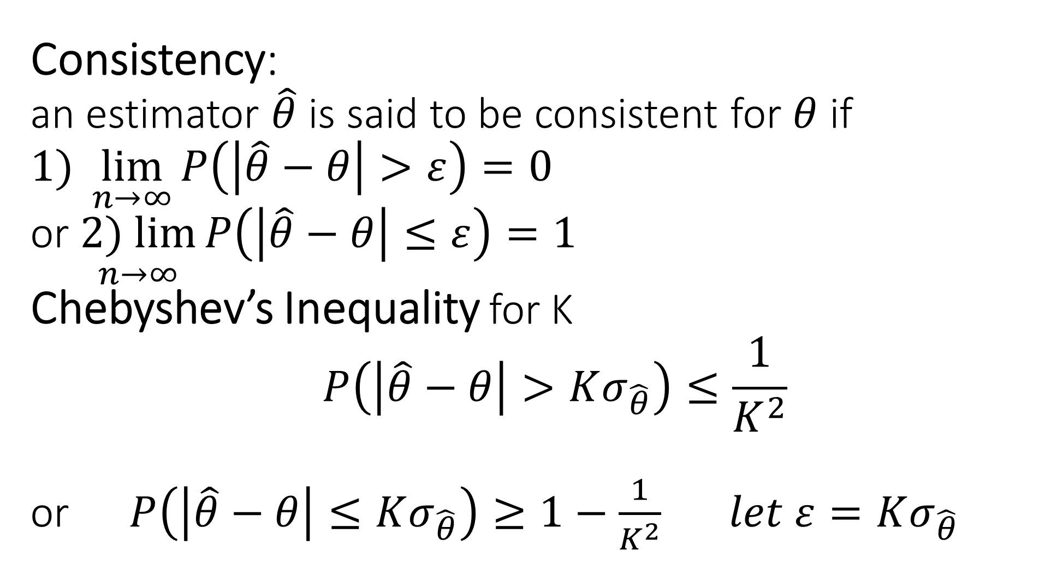
Consistency: an estimator $\hat{θ}$ is said to be consistent for $θ$ if $1) \lim_{n→∞}{P\left(\left|\hat{θ}−θ\right|>ε\right)=0}$ or $\underset{n→∞}{2) lim}{P\left(\left|\hat{θ}−θ\right|≤ε\right)=1}$ Chebyshev’s Inequality for K $${P\left(\left|\hat{θ}−θ\right|>Kσ_{\hat{θ}}\right)≤\frac{1}{K^{2}}}$$ or ${P\left(\left|\hat{θ}−θ\right|≤Kσ_{\hat{θ}}\right)≥1−\frac{1}{K^{2}}} let ε=Kσ_{\hat{θ}}$

Slide 9
Example: show that $\hat{θ}=\overline{X}$ is consistent estimator for $θ$ of $Po(θ$) by using Chebyshev’s Inequality .

Slide 10
Example: let $x_{1},x_{2},…,x_{n}$ be a r.s.s.n from Bernoulli distribution with parameter $θ, is \overline{X}$ consistent estimator for $θ \text{using} \text{Chebyshev}\text{’}\text{s} \text{Inequality}$.

Slide 12
let $x_{1},x_{2},…,x_{n}$ be a r.s.s.n $of$ N(0,$σ^{2})$ , find an estimator for parameter $σ^{2}$ using (m.v.u.e.).

