Slide 1
Educational Statistics Lecture 1 Zhyan R. Ali

Slide 2
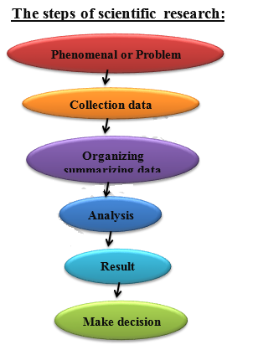
What is Statistics? Definition of Statistics: Statistics is the scientific method concerned with collecting, organizing, and analyzing data for a particular phenomenon. As well as making the reasonable decisions.

Slide 3
Descriptive statistics : Consists numerical and graphical technique to summarize and present the data. Inferential statistics : Consists hypothesis testing, and estimations for generalizing sample results on population.

Slide 4
Variable: Variable is any characteristic that takes different values. Types of Data (Variables): First: Qualitative Data (Variables): are variables which assume non-numerical values.

Slide 5
Example: - Gender (male or female). - Blood group (A , B , AB , O) - Economic state (v. good , good , bad) - Level of education (primary , secondary , high school)

Slide 6
Types of Qualitative Variables 1- Nominal Data (Variables): There is no order among characteristics of variable. For example: - Gender (male , female). - Blood group (A , B , AB , O) 2- Ordinal Variable: There is order among characteristics of variable. Example: - Level of education (primary, secondary, high school) - Economic state (v. good, good, bad)

Slide 7
Second: Quantitative Variables: are variables which assume numerical values. For example: - The number of students - Age (54 , 65.6 , 43 , …….). - Grades of students (78 , 89 , 54 , ……) Types of Quantitative Variables: 1- Discrete Variables: Usually obtained by counting. For example: - The number of students - The number of bacteria on a plate, - The number of children in a family 2- Continuous Variables: Usually obtained by measurement. For example - Age (54, 65.6, 43, …….). - Height (154, 165.6, 143, …….).

Slide 8
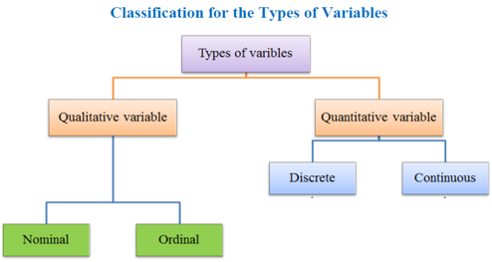

Slide 9
Sources of Data:
Historical sources: Data and information stored and collected by the organs and institutions of the State or organizations. Field sources: Data and information can be obtained from their original sources by correspondence, confrontation or any other way of communication.

Slide 10
Methods of Collection the data: Census method: the collection of data from every element in a population. Samples method: the collection of data from a set of elements in a population

Slide 11
Definition Population:. It’s all the elements or values under a statistical study. Sample:. Sample is a part from the population. types of population: 1) finite population:- it is possible or (easy) to collected the data for example length of students in Salahaddin University 2) infinite population:-it is difficult or (impossible) to collected the data for example number of Bacterium in a filed or fish type fish specific in the Red Sea. 3) Homogenous population: is any population which every element has joint specified characteristics. 4) Non-homogenous population: is any population which every element hasn't joint specified characteristics

Slide 12
Sampling: It is the process of selecting a part from the population. Types of Sampling Techniques: First: Probability (Random) Sampling: Taking the sample from the population in such a way that every element in the population has the same probability (chance) at selection. Second: Non-probability Sampling: Every element in the population does not have equal probability of being chosen.

Slide 13
The types of Random Sampling 1. Simple Random Sampling 2. Systematic Sampling 3. Stratified Sampling 4. Multistage Sampling

Slide 14
1- Simple Random Sampling: Uses this Technique when the population is homogenous. Example: Select 6 students out of 24 students in Statistic class.

Slide 15
2- Systematic Sampling: - Numbering each element in the population. - Dividing the population (N) to (n^{th}) group each group contains (K=N/n) elements and then one element selection from first group randomly as a starting point.

Slide 16
Example: Select (6) students out of (24) students by systematic sampling. Step 1 : Numbering each element in the population. Step 2: Dividing the population to (n=6) groups Step 3 : K=N÷n=24÷6=4 Step 4 : Select a number in group (1) randomly and suppose it is 2 as a starting point. Step 5 : The second number is 2+4=6 , the third number is 6+4=10 , ……. Then your sample is 2nd, 6th, 10th, 14th, 18th, and 22nd students

Slide 17
3- Stratified random sampling: Uses this method when the population is non-homogenous. The sample select by dividing the population into groups (strata) according to some characteristic and then taking samples from each group by using simple random sampling according to the weight of the each group.

Slide 18
Example: In a company there are the following staffs: Select (40) of the staff by stratified Sampling: Male (full time) = 90 Male (part time) = 18 Female (full time) = 9 Female (part time) = 63 $$n_{i}=\frac{N_{i}}{N} ∗n$$ N=population n=sample

Slide 19
Example: if we select a stratified sample size 200 from population size 2000 person divided by male an female by ratio 2:3 (where there exists 800 men and 1200 woman), then we select sample 80 from 800 men and sample 120 from 1200 woman, then 80+120=200 it is the sample size. This select is stratified sample.

Slide 20
Multi-Stage Sampling Design - most commonly used sampling design in practice -involves more than one stage of sampling and / or a combination of two or more sampling designs

Slide 21
The types of Data Data: is the set of observation Raw data : it is data without arrangement. Grouped data: it is data with or after arrangement or grouped. Example1: degree students : 62,73,60,66,75,71,69,68,70 this data is raw data example2:Let the blood types of 40 persons are as follows: O O A B A O A A A O B O B O O A O O A A A A AB A B A A O O A O O A A A O A O O AB
Ratio % | frequency | Blood group
40 | 16 | O
45 | 18 | A
10 | 4 | B
5 | 2 | AB
100 | 40 | Total
This data is
grouped data

Slide 22
Data presentation After collecting data, the next step should be expressing it in some form such as: 1- Frequency distribution, 2- Graphical presentation 1- Frequency distribution: Frequency distribution is the organizing of raw data in table form, used classes and frequencies.

Slide 23
Example : The following data (raw data) represent weights of (30) children: 20 , 10 , 8.6 , 7 , 5.9 , 6 , 12 , 8 , 14 , 5 , 9 , 16.5 , 25 , 16 , 19 , 20.9 , 7.8 , 15 , 18 , 24 , 9 , 7 , 15 , 16.9 , 11 , 8 , 26 , 17.6 , 21 , 10 The following data (frequency distribution) represent weights of (30) children:
classes | Frequency (f_{i})
5-9 | 9
9-13 | 6
13-17 | 6
17-21 | 5
21-25 | 2
25-29 | 2
Total | 30
There are (6) classes; each class has a lower class limit and upper class limit

Slide 24
Relative frequency ($f_{i}^{∗})$The ratio of frequency of class to the total of frequencies. $$f_{i}^{∗}=\frac{f_{i}}{\sum_{i=1}^{n}{f_{i}}}$$

Slide 25
Frequency distribution for qualitative data: Frequency distribution for qualitative data lists all classes and the number of elements that belong to each of the classes example: The following data represent eye's color for 10 students : Brown Blue Black Brown Black Black Brown Black Blue Black Construct the frequency distribution, and Find Relative frequency .
Frequency (fi) | classes
5 | Black
3 | Brown
2 | Blue
10 | Total

Slide 26
Example: represent by table the blood types of 40 persons are as follows : O O A B A O A A A O B O B O O A O O A A A A AB A B A A O O A O O A A A O A O O AB Construct the frequency distribution, and Find Relative frequency .
Frequency (fi) | Blood group
16 | O
18 | A
4 | B
2 | AB
40 | Total

Slide 27
H.W: represent the following data by frequency table. And Find Relative frequency . Aya, Nawal, Fatn, Aya, Fatn, Fatn, Huda, Aya, Suha, Suha, Aya, Aya, Fatn, Suha, Aya, Huda
H.W: represent the following data by frequency table. And Find Relative frequency . 65,77, 56, 65, 65, 70, 65, 77, 72, 69, 70, 68, 59, 56, 77, 78, 66, 66, 65, 61, 60, 61,78, 70, 70

Slide 28
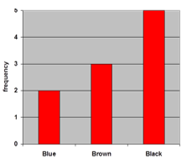
Graphical presentation It is another method for presenting and summarizing grouped data. Graphical presentation for qualitative data: 1- Bar chart: Bar chart is a graph that displays the classes (characteristics) on the horizontal axis and the frequency on the vertical axis. Example (1): Draw the bar chart from the following data:
Frequency (fi) | classes
5 | Black
3 | Brown
2 | Blue
10 | Total

Slide 29
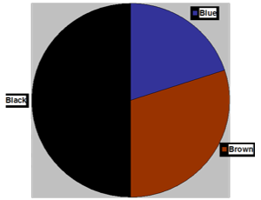
2- Pie chart: is a circle divided to number of sectors which are representing characteristics of variable. $the angle of each sector=\frac{f_{i}}{\sum_{i=1}^{n}{f_{i}}}$*360
Example (1): Draw the bar chart from the following data:
Frequency (fi) | classes
5 | Black
3 | Brown
2 | Blue
10 | Total

