Slide 1
Educational Statistics
Lecture 2

Slide 3
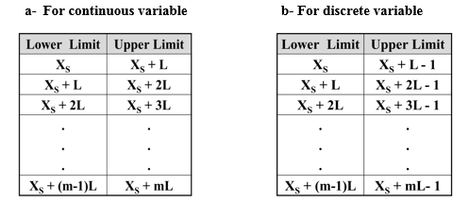

Slide 4
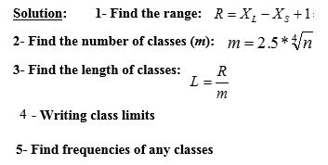
Example for continuous variables: example1: the following data represent the times (minutes) for 50 students, which are working on the internet during one day.

Slide 5
classes |  | Frequency
Lower limits | Upper limits
7 | 19 | 6
19 | 31 | 10
31 | 43 | 13
43 | 55 | 8
55 | 67 | 5
67 | 79 | 6
79 | 91 | 2
total |  | 50

Slide 7
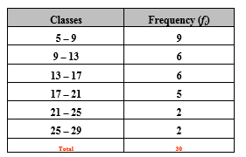

Slide 9
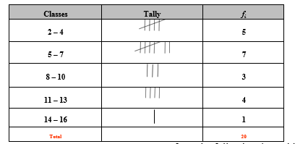

Slide 11
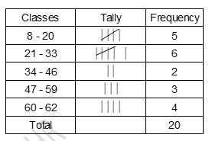

Slide 13
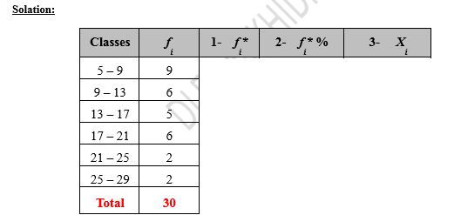

Slide 14
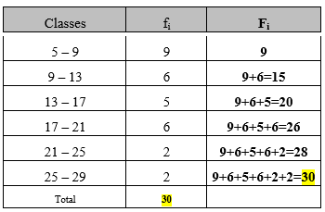

Slide 15
classes | Frequency fi | Fi
1-3 | 4
3-5 | 10
5-7 | 16
7-9 | 12
9-11 | 6
11-13 | 2
total | 50

Slide 16
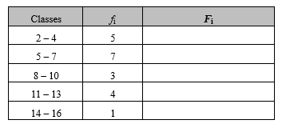

Slide 17
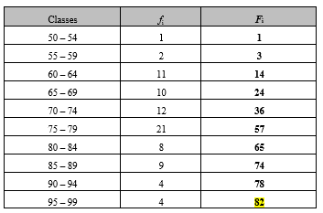

Slide 18
