Slide 1
Differences between prokaryote and eukaryote genetic material
From the perspective of molecular biology, a major difference between prokaryotic and eukaryotic cells is that a eukaryote has a nuclear envelope, which surrounds the genetic material to form a nucleus and separates the DNA from the other cellular contents.
In prokaryotic cells, the genetic material is in close contact with other components of the cell—a property that has important consequences for the way in which genes are controlled.
Another fundamental difference between prokaryotes and eukaryotes lies in the packaging of their DNA. In eukaryotes, DNA is closely associated with a special class of proteins, the histones, to form tightly packed chromosomes.

Slide 2
This complex of DNA and histone proteins is termed chromatin, which is the stuff of eukaryotic chromosomes. Histone proteins limit the accessibility of enzymes and other proteins that copy and read the DNA but they enable the DNA to fit into the nucleus.
Archaea also have some histone proteins that complex with DNA, but the structure of their chromatin is different from that found in eukaryotes. However, eubacteria do not possess histones, so their DNA does not exist in the highly ordered, tightly packed arrangement found in eukaryotic cells instead they have euprotein.
The copying and reading of DNA are therefore simpler processes in eubacteria.
Genes of prokaryotic cells are generally on a single, circular molecule of DNA, the chromosome of the prokaryotic cell.

Slide 3
In eukaryotic cells, genes are located on multiple, usually linear DNA molecules (multiple chromosomes).
This generalization—a single, circular chromosome in prokaryotes and multiple, linear chromosomes in eukaryotes—is not always true.
A few bacteria have more than one chromosome, and important bacterial genes are frequently found on other DNA molecules called plasmids (The term plasmid was first introduced by the American molecular biologist Joshua Lederberg in 1952).
Furthermore, in some eukaryotes, a few genes are located on circular DNA molecules found outside the nucleus the 2-micrometre-ring in Saccharomyces cerevisiae .

Slide 4
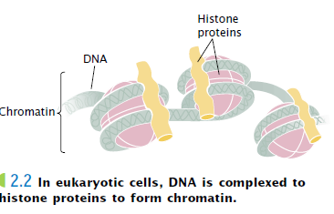
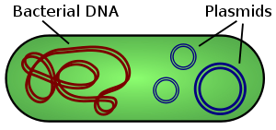

Slide 5
The Structure of DNA
It is useful to consider the structure of DNA at three levels of increasing complexity, known as the primary, secondary, and tertiary structures of DNA. The primary structure of DNA refers to its nucleotide structure and how the nucleotides are joined together.
The secondary structure refers to DNA’s stable three-dimensional configuration, the helical structure worked out by Watson and Crick. In DNA’s tertiary structures, which are the complex packing arrangements of double stranded DNA in chromosomes.

Slide 6
The Primary Structure of DNA
The primary structure of DNA consists of a string of nucleotides joined together by phosphodiester linkages.
Nucleotides DNA is typically a very long molecule and is therefore termed a macromolecule. For example, within each human chromosome is a single DNA molecule that, if stretched out straight, would be several centimeters in length. In spite of its large size, DNA has a relatively simple structure: it is a polymer, a chain made up of many repeating units linked together.
As already mentioned, the repeating units of DNA are nucleotides, each comprising three parts: (1) a sugar, (2) a phosphate, and (3) a nitrogen-containing base. The sugars of nucleic acids—called pentose sugars— have five carbon atoms, numbered 1`, 2`, 3`, and so forth .

Slide 7
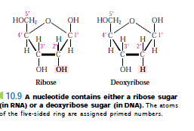
Four of the carbon atoms are joined by an oxygen atom to form a five-sided ring; the fifth (5`) carbon atom projects upward from the ring. Hydrogen atoms or hydroxyl groups (OH) are attached to each carbon atom.

Slide 8
The sugars of DNA and RNA are slightly different in structure. RNA’s ribose sugar has a hydroxyl group attached to the 2`-carbon atom, whereas DNA’s sugar, called deoxyribose, has a hydrogen atom at this position and contains one oxygen atom fewer overall. This difference gives rise to the names ribonucleic acid (RNA) and deoxyribonucleic acid (DNA).

Slide 9
This minor chemical difference is recognized by all the cellular enzymes that interact with DNA or RNA, thus yielding specific functions for each nucleic acid. Further, the additional oxygen atom in the RNA nucleotide makes it more reactive and less chemically stable than DNA. For this reason, DNA is better suited to serve as the long-term repository of genetic information.
The second component of a nucleotide is its nitrogenous base, which may be of two types—a purine or a pyrimidine . Each purine consists of a six-sided ring attached to a five-sided ring, whereas each pyrimidine consists of a six-sided ring only.

Slide 10
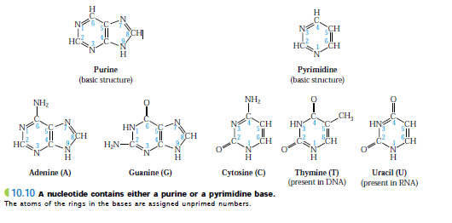
DNA and RNA both contain two purines, adenine and guanine (A and G), which differ in the positions of their double bonds and in the groups attached to the six-sided ring. There are three pyrimidines found in nucleic acids: cytosine (C),thymine (T), and uracil (U). Cytosine is present in both DNA and RNA; however, thymine is restricted to DNA, and uracil is found only in RNA. The three pyrimidines differ in the groups or atoms attached to the carbon atoms of the ring and in the number of double bonds in the ring.

Slide 11
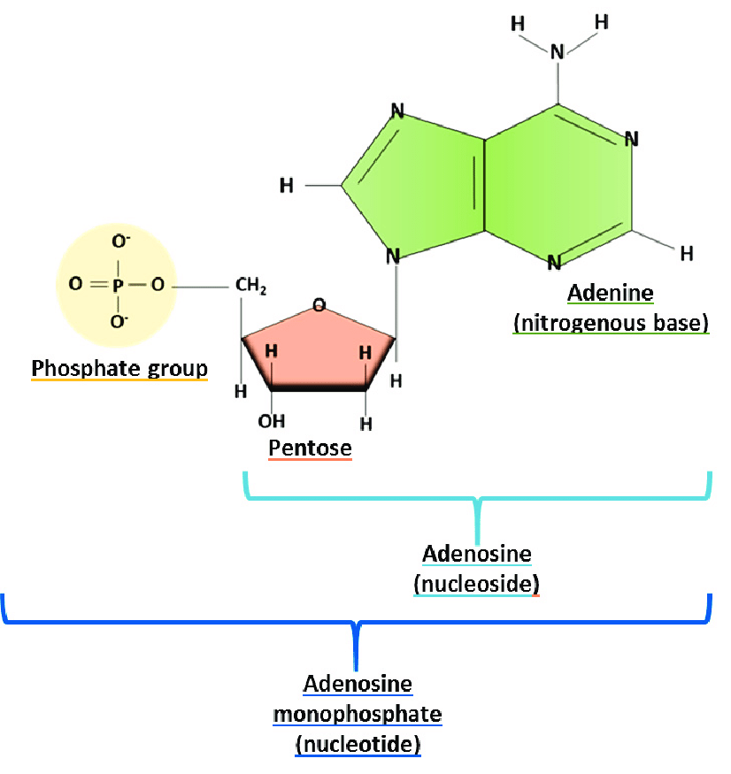
In a nucleotide, the nitrogenous base always forms a covalent bond with the 1_-carbon atom of the sugar. A deoxyribose (or ribose) sugar and a base together are referred to as a nucleoside.

Slide 12
The third component of a nucleotide is the phosphate group, which consists of a phosphorus atom bonded to four oxygen atoms . Phosphate groups are found in every nucleotide and frequently carry a negative charge, which makes DNA acidic. The phosphate is always bonded to the 5`-carbon atom of the sugar in a nucleotide.
The DNA nucleotides are properly known as deoxyribonucleotides or deoxyribonucleoside 5`monophosphates. Because there are four types of bases, there are four different kinds of DNA nucleotides .The equivalent RNA nucleotides are termed ribonucleotides or ribonucleoside 5`monophosphates.

Slide 13
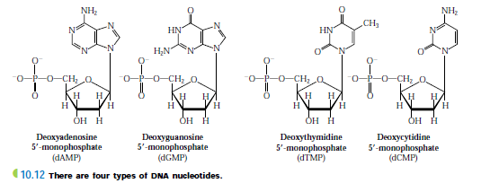

Slide 14
Polynucleotide strands
DNA is made up of many nucleotides connected by covalent bonds, which join the 5`phosphate group of one nucleotide to the 3`carbon atom of the next nucleotide .These bonds, called phosphodiester linkages, are relatively strong covalent bonds; a series of nucleotides linked in this way constitutes a polynucleotide strand.
The backbone of the polynucleotide strand is composed of alternating sugars and phosphates; the bases project away from the long axis of the strand.
An important characteristic of the polynucleotide strand is its direction, or polarity.

Slide 15
At one end of the strand a phosphate group is attached only to the 5`-carbon atom of the sugar in the nucleotide. This end of the strand is therefore referred to as the 5`end. The other end of the strand, referred to as the 3`end, has an OH group attached to the 3`-carbon atom of the sugar. RNA nucleotides also are connected by phosphodiester linkages to form similar polynucleotide strands.

Slide 16
