Slide 1
A Comparison of Bacterial and Eukaryotic Translation
First, we should emphasize that the genetic code of bacterial and eukaryotic cells is virtually identical; the only difference is in the amino acid specified by the initiation codon. In bacterial cells, AUG codes for a modified type of methionine, N-formylmethionine, whereas, in eukaryotic cells, AUG codes for unformylated methionine.
Another difference is that transcription and translation take place simultaneously in bacterial cells, but the nuclear envelope may separate these processes in eukaryotic cells. The physical separation of transcription and translation has important implications for the control of gene expression,

Slide 2
Yet another difference is that mRNA in bacterial cells is short lived, typically lasting only a few minutes, but the longevity of mRNA in eukaryotic cells is highly variable and is frequently hours or days. Thus the synthesis of a particular bacterial protein ceases very quickly after transcription of the corresponding mRNA stops, but protein synthesis in eukaryotic cells may continue long after transcription has ended.
In both bacterial and eukaryotic cells, aminoacyl-tRNA synthetases attach amino acids to their appropriate tRNAs; the chemical reaction employed is the same.

Slide 3
There are significant differences in the sizes and compositions of bacterial and eukaryotic ribosomal subunits. For example, the large subunit of the eukaryotic ribosome contains three rRNAs, whereas the bacterial ribosome contains only two. These differences allow antibiotics and other substances to inhibit bacterial translation while having no effect on the translation of eukaryotic nuclear genes.

Slide 4
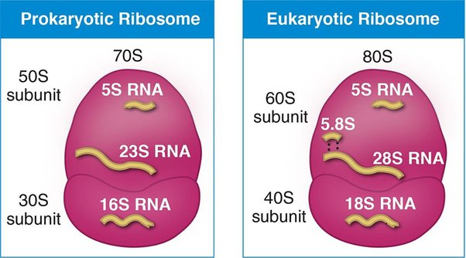

Slide 5
Other fundamental differences lie in the process of initiation. In bacterial cells, the small subunit of the ribosome attaches directly to the region surrounding the start codon through hydrogen bonding between the ShineDalgarno consensus sequence in the 5 untranslated region of the mRNA and a sequence at the 3 end of the 16S rRNA.
In contrast, the small subunit of a eukaryotic ribosome first binds to proteins attached to the 5 cap on mRNA and then migrates down the mRNA, scanning the sequence until it encounters the first AUG initiation codon.

Slide 6
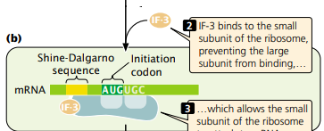

Slide 7
Additionally, more initiation factors take part in eukaryotic initiation (9) than in bacterial initiation (3).
In prokaryotic cells three elongation factors required while in eukaryote only two elongation factors required .
The speed of amino acid addition is 17–21 amino acids/second while in eukaryotic cell is slower, 6–9 amino acids/ second
Translation in eukaryotic cells terminates in a similar way, except that there are two release factors: eRF1, which recognizes all three termination codons, and eRF2, which binds GTP and stimulates the release of the polypeptide from the ribosome.

Slide 8
The Posttranslational Modifications of Proteins
After translation, proteins in both prokaryotic and eukaryotic cells may undergo alterations termed posttranslational modifications. A number of different types of modifications are possible.
The formyl group or the entire methionine residue may be removed from the amino end of a protein. Some proteins are synthesized as larger precursor proteins and must be cleaved and trimmed by enzymes before the proteins can become functional.

Slide 9
The functions of many proteins depend critically on the proper folding of the polypeptide chain; some proteins spontaneously fold into their correct shapes, but, for others, correct folding may initially require the participation of other molecules called molecular chaperones.
Molecular chaperones are a group of proteins that assist in protein proper folding. They not only prevent protein misfolding and aggregation, but also target misfolded proteins for degradation. Despite differences in structure, all types of chaperones share a common general feature, that recognizes and interacts with the misfolded protein.

Slide 10
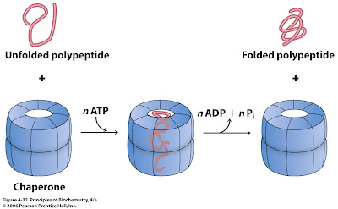

Slide 11
Another modification of some proteins is the removal of 15 to 30 amino acids, called the signal sequence. The signal sequence helps direct a protein to a specific location within the cell, after which the sequence is removed by special enzymes. Amino acids within a protein may also be modified: phosphates, carboxyl groups, and methyl groups are added to some amino acids.
Phosphorylation: Phosphorylation involves the addition of a phosphate group to specific amino acid residues, typically serine, threonine, or tyrosine,. Phosphorylation is a reversible modification and is catalyzed by enzymes called kinases, while phosphatases catalyze the removal of phosphate groups. Phosphorylation regulates protein activity, cellular signaling, and protein-protein interactions.

Slide 12
Glycosylation: Glycosylation is the addition of carbohydrate moieties to specific amino acid residues, usually serine, threonine, or asparagine.. Glycosylation plays important roles in protein folding, stability, cell-cell recognition, and immune responses.
Acetylation: Acetylation involves the addition of an acetyl group to the amino group of lysine residues. This modification is catalyzed by acetyltransferases and can be removed by deacetylases. Acetylation regulates protein function, stability, and protein-protein interactions. Histone acetylation, a specific form of acetylation, is particularly important in the regulation of gene expression.

Slide 13
Methylation: Methylation involves the addition of a methyl group to specific amino acid residues, including lysine, arginine, and histidine. Methyl group play a major role in epigenetic process or gene silencing.
Ubiquitination: Ubiquitination involves the covalent attachment of ubiquitin, a small protein, to lysine residues on target proteins. Ubiquitination is catalyzed by a cascade of enzymes, including ubiquitin-activating enzymes (E1), ubiquitin-conjugating enzymes (E2), and ubiquitin ligases (E3). Ubiquitination targets proteins for degradation by the proteasome.

Slide 14
