Slide 1
DNA replication
Besides maintaining the integrity of DNA sequences by DNA repair, all organisms must duplicate their DNA accurately before every cell division( S phase). DNA replication occurs at polymerization rates of about 500 nucleotides per second in bacteria and about 50 nucleotides per second in mammals. Clearly, the proteins that catalyze this process must be both accurate and fast. Speed and accuracy are achieved by means of a multienzyme complex that guides the process and constitutes an elaborate "replication machine."

Slide 2
Semiconservative Replication
The Watson–Crick model for DNA replication assumed that as new strands of DNA are made, they follow the usual base-pairing rules of A with T and G with C. The model also proposed that the two parental strands separate and that each then serves as a template for a new progeny strand. This is called semiconservative replication because each daughter duplex has one parental strand and one new strand.
In other words, one of the parental strands is “conserved” in each daughter duplex. However, this is not the only possibility.

Slide 3
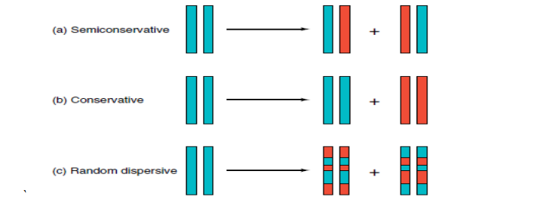
Another potential mechanism is conservative replication, in which the two parental strands stay together and somehow produce another daughter helix with two completely new strands. Yet another possibility is random dispersive replication, in which the DNA becomes fragmented so that new and old DNAs coexist in the same strand after replication .

Slide 4
Replication process
DNA Replication, like all biological polymerization processes, proceeds in three enzymatically catalyzed and coordinated steps:
initiation,
elongation
and termination.

Slide 5
Initiation
For a cell to divide, it must first replicate its DNA. This process is initiated at particular points in the DNA, known as "origins", which are targeted by initiator proteins. Sequences used by initiator proteins tend to be "AT-rich" (rich in adenine and thymine bases), because A-T base pairs have two hydrogen bonds (rather than the three formed in a C-G pair) which are easier to unzip. Once the origin has been located, these initiators recruit other proteins and form the pre-replication complex, which unzips the double-stranded DNA.

Slide 6
Elongation
DNA polymerase has 5'-3' activity. All known DNA replication systems require a free 3' hydroxyl group before synthesis can be initiated (Important note: the DNA template is read in 3' to 5' direction whereas a new strand is synthesized in the 5' to 3' direction—this is often confused). All cellular life use a primase to synthesize a short RNA primer with a free 3' OH group which is subsequently elongated by a DNA polymerase.
The replication fork is a structure that forms within the nucleus during DNA replication. It is created by helicases, which break the hydrogen bonds holding the two DNA strands together. The resulting structure has two branching "prongs", each one made up of a single strand of DNA.

Slide 7
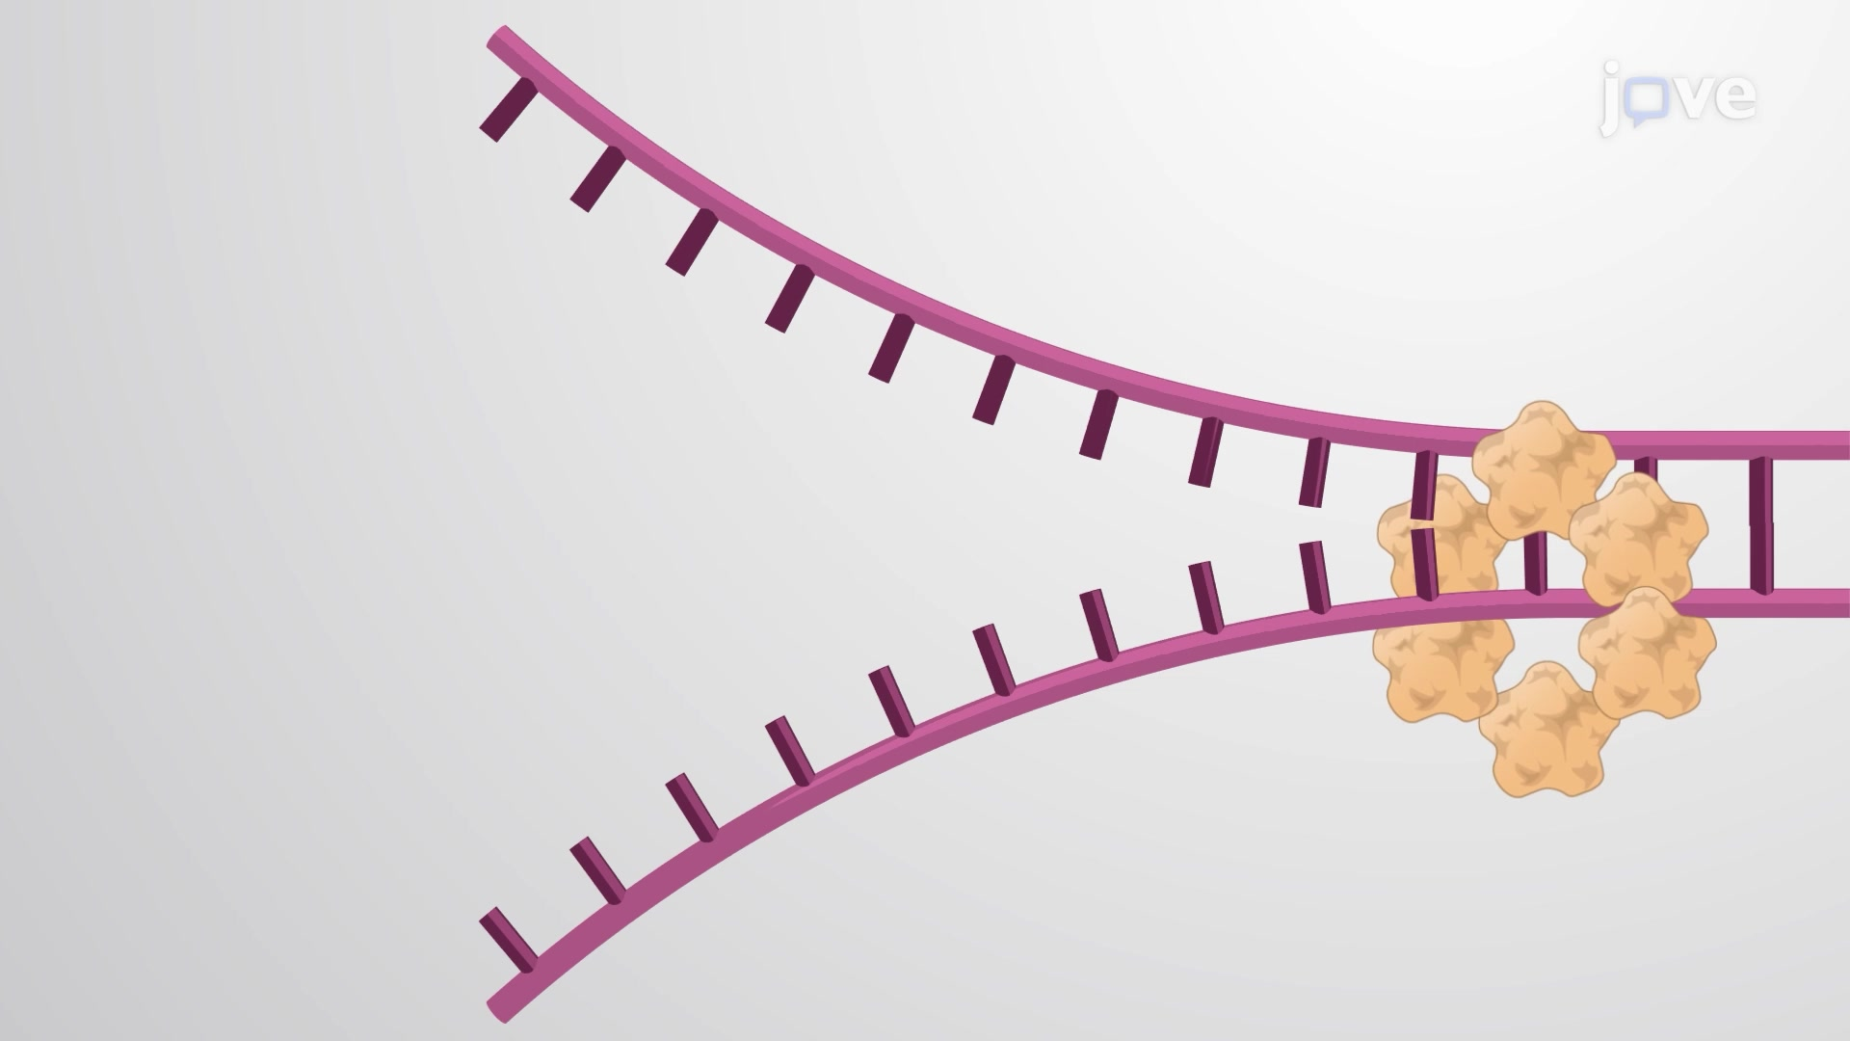

Slide 8
These two strands serve as the template for the leading and lagging strands, which will be created as DNA polymerase matches complementary nucleotides to the templates; the templates may be properly referred to as the leading strand template and the lagging strand template
DNA is always synthesized in the 5' to 3' direction. Since the leading and lagging strand templates are oriented in opposite directions at the replication fork, a major issue is how to achieve synthesis of nascent (new) lagging strand DNA, whose direction of synthesis is opposite to the direction of the growing replication fork

Slide 9
Lagging strand
The lagging strand is the strand of nascent DNA whose direction of synthesis is opposite to the direction of the growing replication fork. Because of its orientation, replication of the lagging strand is more complicated as compared to that of the leading strand.
The lagging strand is synthesized in short, separated segments. On the lagging strand template, a primase "reads" the template DNA and initiates synthesis of a short complementary RNA primer. A DNA polymerase extends the primed segments, forming Okazaki fragments. The RNA primers are then removed and replaced with DNA, and the fragments of DNA are joined together by DNA ligase.
DNA polymerase III is responsible for extension of the primers added during replication of the lagging strand. Primer removal is performed by DNA polymerase I.

Slide 10
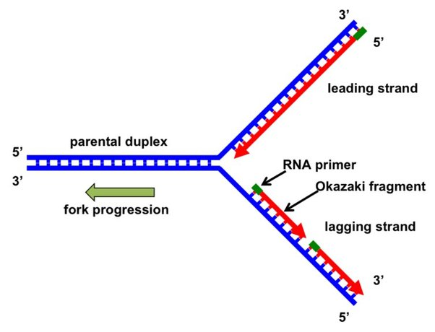

Slide 11
Termination
Termination requires that the progress of the DNA replication fork must stop or be blocked. Termination at a specific locus, when it occurs, involves the interaction between two components: (1) a termination site sequence in the DNA, and (2) a protein which binds to this sequence to physically stop DNA replication. In various bacterial species, this is named the DNA replication terminus site-binding protein, or Ter protein

Slide 12
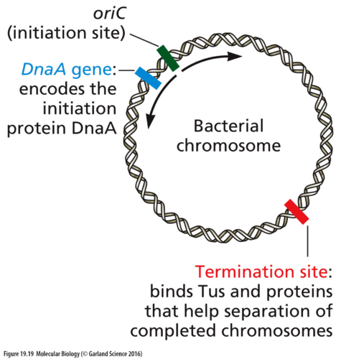

Slide 13
Active enzymes and Proteins in DNA replication
1- DNA Helicase : Also known as helix destabilizing enzyme. Unwinds the DNA double helix at the Replication Fork.
2- DNA Polymerase: Builds a new duplex DNA strand by adding nucleotides in the 5' to 3' direction. Also performs proof-reading and error correction. There exist many different types of DNA Polymerase, each of which perform different functions in different types of cells.
3- Single-Strand Binding (SSB) Proteins: Bind to ssDNA and prevent the DNA double helix from re-annealing after DNA helicase unwinds it, thus maintaining the strand separation, and facilitating the synthesis of the nascent strand.

Slide 14
4-Topoisomerase: Relaxes the DNA from its super-coiled nature in eukaryote
5- DNA Gyrase: Relieves strain of unwinding by DNA helicase; this is a specific type of topoisomerase in bacteria
6- DNA Ligase: Re-anneals the semi-conservative strands and joins Okazaki Fragments of the lagging strand.
7- Primase: Provides a starting point of RNA (or DNA) for DNA polymerase to begin synthesis of the new DNA strand.

Slide 15
