Slide 1
RNA in the Primeval World
Life requires two basic functions. First, living organisms must be able to store and faithfully transmit genetic information during reproduction. Second, they must have the ability to catalyze chemical transformations, to fire the reactions that drive life processes.
It was long believed that the functions of information storage and chemical transformation are handled by two entirely different types of molecules. Genetic information is stored in nucleic acids. Catalysis of chemical transformations was held to be the exclusive domain of certain proteins that serve as biological catalysts or enzymes, making reactions take place rapidly within the cell.

Slide 2
This biochemical dichotomy — nucleic acid for information, proteins for catalysts — revealed a dilemma in our understanding of the early stages in the evolution of life. Which came first: proteins or nucleic acids?
If nucleic acids carry the coding instructions for proteins, how could proteins be generated without them? Because nucleic acids are unable to copy themselves, how could they be generated without proteins? If DNA and proteins each require the other, how could life begin?

Slide 3
This apparent paradox disappeared in 1981 when Thomas Cech and his colleagues discovered that RNA can serve as a biological catalyst. They found that RNA from the protozoan Tetrahymena thermophila can excise 400 nucleotides from its RNA in the absence of any protein.
Other examples of catalytic RNAs have now been discovered in different types of cells. Called ribozymes, these RNA molecules can cut out parts of their own sequences, connect some RNA molecules together, replicate others, and even catalyze the formation of peptide bonds between amino acids. The discovery of ribozymes complements other evidence suggesting that the original genetic material was RNA.

Slide 4
Ribozymes that were self-replicating probably first arose between 3.5 billion and 4 billion years ago and may have begun the evolution of life on Earth. Early life was an RNA world, with RNA molecules serving both as carriers of genetic information and as catalysts that drove the chemical reactions needed to sustain and perpetuate life. These catalytic RNAs may have acquired the ability to synthesize protein-based enzymes, and became relegated to the role of information storage and transfer.
DNA, with its chemical stability and faithful replication, eventually replaced RNA as the primary carrier of genetic information. In modern cells, RNA still plays a vital role in both DNA replication and protein synthesis.

Slide 5
RNA as Genetic Material
In most organisms, DNA carries the genetic information.However, a few viruses utilize RNA, not DNA, as their genetic material. This fact was demonstrated in 1956 by Heinz Fraenkel-Conrat and Bea Singer, who worked with tobacco mosaic virus (TMV), a virus that infects and causes disease in tobacco plants. The tobacco mosaic virus possesses a single molecule of RNA surrounded by a helically arranged cylinder of protein molecules. Fraenkal-Conrat found that, after separating the RNA and protein of TMV, he could remix them and obtain intact, infectious viral particles.

Slide 6
With Singer, Fraenkal-Conrat then created hybrid viruses by mixing RNA and protein from different strains of TMV .When these hybrid viruses infected tobacco leaves, new viral particles were produced. The new viral progeny were identical to the strain from which the RNA had been isolated and did not exhibit the characteristics of the strain that donated the protein.
These results showed that RNA carries the genetic information in TMV. Also in 1956, Alfred Gierer and Gerhard Schramm demonstrated that RNA isolated from TMV is sufficient to infect tobacco plants and direct the production of new TMV particles, confirming that RNA carries genetic instructions.

Slide 8
Properties of RNA
RNA is a single-stranded molecule and not a double helix, one of the consequences of this, is that RNA can form a variety of three-dimensional molecular complexes than DNA.
RNA has ribose sugar in its nucleotides, rather than deoxyribose. These two sugars differ from each other in the presence or absence of an Oxygen atom.
Ribose sugar is also a cyclical structure consisting of 5 Carbon and one Oxygen just like DNA. But the major difference is the presence of extra OH group in 2’ Carbon of ribose which is absent in deoxyribose sugar.

Slide 9
The OH group in 2’ Carbon makes the RNA molecule prone to hydrolysis.
Some studies have also concluded that this chemical liability of RNA due to extra OH- the group has led to DNA being the genetic storehouse as it lacks OH group in 2’Carbon making it more stable to hold information.
RNA nucleotides carry the nitrogenous bases, Purines, and Pyrimidines. But in RNA in place of Pyrimidine Thymine, Uracil is present which too forms hydrogen bonding with Adenine just as Thymine does in DNA molecule.
Thymine is easily oxidized. So it is protected from oxygen in the nucleus. Outside of the nucleus, it is quickly destroyed. Uracil is resistant to oxidation and is utilized in RNA, which exists outside of the nucleus.

Slide 11
Functions of RNA
The ribonucleic acid – RNA, which are mainly composed of nucleic acids, are involved in a variety of functions within the cell and are found in all living organisms including bacteria, viruses, plants, and animals.
These nucleic acid functions as a structural molecule in cell organelles and are also involved in the catalysis of biochemical reactions. The different types of RNA are involved in various cellular process. The primary functions of RNA:

Slide 12
Facilitate the translation of DNA into proteins
Functions as an adapter molecule in protein synthesis
Serves as a messenger between the DNA and the ribosomes.
They are the carrier of genetic information in the virus.
Promotes the ribosomes to choose the right amino acid which is required in building up of new proteins in the body.

Slide 13
RNA secondary structure
Although RNA is usually single stranded, short complementary regions within a nucleotide strand can pair and form secondary structures.
These RNA secondary structures are often called hairpin-loops or stem-loop structures. When two regions within a single RNA molecule pair up, the strands in those regions must be antiparallel, with pairing between cytosine and guanine and between adenine and uracil (although occasionally guanine pairs with uracil).

Slide 14
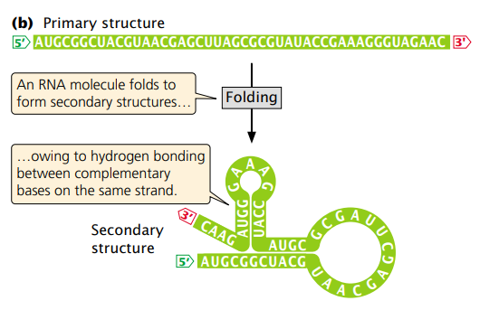

Slide 15
