Slide 1
Eukaryotic promoters
Eukaryotic promoters are much larger and more intricate than prokaryotic promoters. However, both have a sequence similar to the -10 sequence of prokaryotes. In eukaryotes, this sequence is called the TATA box (core promoter), and has the consensus sequence TATAAA on the coding strand. It is located at -25 to -35 bases relative to the initiation (+1) site.
This sequence is not identical to the E. coli TATA box, but it conserves the A–T rich element. The thermostability of A–T bonds is low and this helps the DNA template to locally unwind in preparation for transcription.

Slide 2
in addition to the TATA box, other binding sites are found in some promoters. Some biologists prefer to restrict the range of the eukaryotic promoter to the core promoter, or polymerase binding site, and refer to these additional sites as promoter-proximal elements, because they are usually found within a few hundred base pairs upstream of the transcriptional start site.
Examples of these elements are the CAAT box, with the consensus sequence 5’-CCAAT-3’ and the GC box, with the consensus sequence 5’-GGGCGG-3’. octamer boxes (ATTTGCAT). These elements bind cellular factors that increase the efficiency of transcription initiation and are often identified in more “active” genes that are constantly being expressed by the cell.

Slide 3
Specific transcription factors can bind to these promoter-proximal elements to regulate gene transcription. A given gene may have its own combination of these specific transcription-factor binding sites. There are hundreds of transcription factors in a cell, each of which binds specifically to a particular DNA sequence motif.
When transcription factors bind to the promoter just upstream of the encoded gene, it is referred to as a cis-acting element, because it is on the same chromosome just next to the gene. Transcription factors respond to environmental stimuli that cause the proteins to find their binding sites and initiate transcription of the gene that is needed.

Slide 5
Like prokaryotic cells, the transcription of genes in eukaryotes requires the action of an RNA polymerase to bind to a DNA sequence upstream of a gene in order to initiate transcription of that gene.
However, unlike prokaryotic cells, the eukaryotic RNA polymerase requires other proteins, or transcription factors (a protein that binds to DNA and regulates gene expression by either promoting or suppressing transcription) to facilitate transcription initiation.
RNA polymerase by itself cannot initiate transcription in eukaryotic cells without the aid of transcriptional factors .

Slide 6
There are two types of transcription factors that regulate eukaryotic transcription:
General (or basal) transcription factors bind to the core promoter region to assist the binding of RNA polymerase.
. Specific transcription factors bind to various regions outside of the core promoter region and interact with the proteins at the core promoter to enhance or repress the activity of the polymerase.
The names of the basal transcription factors begin with “TFII” (this is the transcription factor for RNA polymerase II) and are specified with the letters A–J. The transcription factors systematically fall into place on the DNA template, with each one further stabilizing the preinitiation complex and contributing to the recruitment of RNA polymerase II.

Slide 7
Turning Genes Off: Transcriptional Repressors
Like prokaryotic cells, eukaryotic cells also have mechanisms to prevent transcription. Transcriptional repressors can bind to regulatory promoter or enhancer regions and block transcription. Like the transcriptional activators, repressors respond to external stimuli to prevent the binding of activating transcription factors.

Slide 8
Initiation of transcription
Assembly of the basal transcription apparatus
The basic transcriptional machinery that binds to DNA at the start site is called the basal transcription apparatus and is required to initiate minimal levels of transcription. It consists of RNA polymerase, a series of general transcription factors, and a complex of proteins known as the mediator.
The general transcription factors include TFIIA, TFIIB, TFIID, TFIIE, TFIIF, and TFIIH, in which TFII stands for transcription factor for RNA polymerase II and the letter designates the individual factor.

Slide 9
TFIID binds to the TATA box and positions the active site of RNA polymerase II so that it begins transcription at the correct place. TFIID consists of at least nine polypeptides. One of them is the TATA-binding protein (TBP), which recognizes and binds to the TATA box on the DNA template.
Other proteins, called TBP-associated factors (TAFs) combine with TBP to form the complete TFIID transcription factor. The large holoenzyme consisting of RNA polymerase, additional transcription factors, and the mediator are thought to preassemble and bind as a unit to TFIID. The other transcription factors provide additional functions: TFIIA helps to stabilize the interaction between TBP and DNA, TFIIB plays a role in the selection of the start site,

Slide 10
The mediator plays a role in communication between the basal transcription apparatus and transcriptional activator proteins through coactivator.
Regulatory promoter
The regulatory promoter is located immediately upstream of the core promoter. Transcriptional activator proteins bind to these sequences and, make contact with the mediator in the basal transcription apparatus and affect the rate at which transcription is initiated. Some regulatory promoters also contain repressing sequences, which are bound by proteins that lower the rate of transcription .

Slide 11
Enhancers DNA
sequences that increase the rate of transcription at distant genes are called enhancers. Furthermore, the precise position of an enhancer relative to a gene’s transcriptional start site is not critical; most enhancers can stimulate any promoter in their vicinities, and an enhancer may be upstream or downstream from the affected gene.
Enhancers contain sequences that are recognized by transcriptional activator proteins. How does the binding of a transcriptional activator protein to an enhancer affect the initiation of transcription at a gene thousands of nucleotides away? The answer is that the DNA between the enhancer and the promoter loops out by DNA bending protein, allowing the enhancer and the promoter to lie close to each other.
Transcriptional activator proteins bound to the enhancer interact with transcriptional factors bound to the promoter and stimulate the transcription of the adjacent gene.

Slide 12
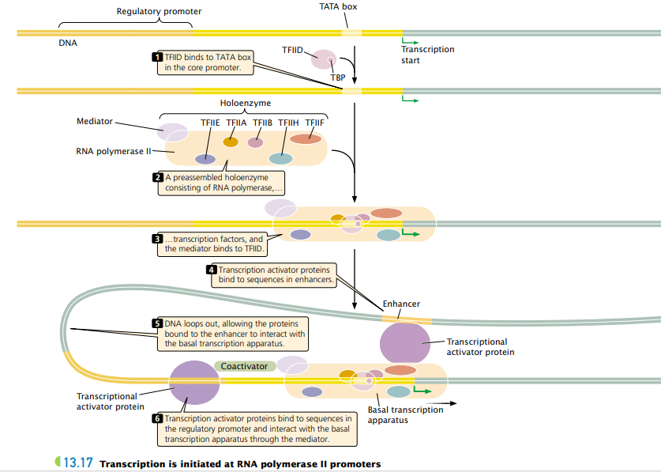

Slide 13
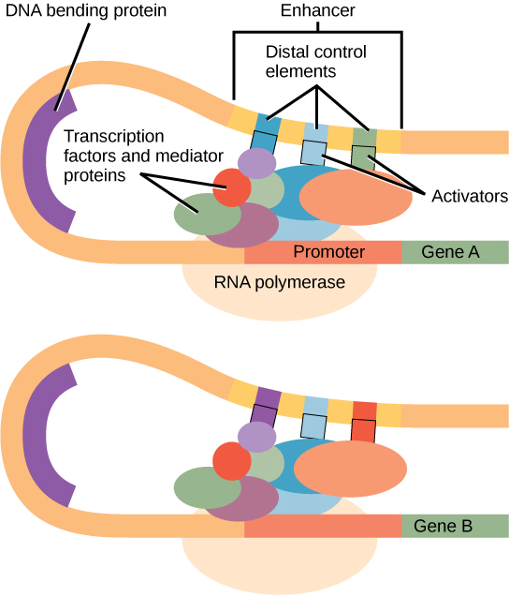

Slide 14
Elongation Phase
TFIIH has two functions:
It is a helicase, which means that it can use ATP to unwind the DNA helix, allowing transcription to begin.
In addition, it phosphorylates RNA polymerase II which causes this enzyme to change its conformation and dissociate from other proteins in the initiation complex.
RNA synthesis occurs in the 5’ → 3’ direction with the RNA polymerase catalyzing a nucleophilic attack by the 3-OH of the growing RNA chain on the alpha-phosphorus atom on an incoming ribonucleoside 5-triphosphate.
The RNA molecule made from a protein-coding gene by RNA polymerase II is called a primary transcript.

Slide 15
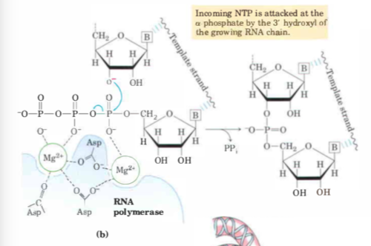

Slide 16
Termination ( several model proposed for termination)
Polyadenylation-mediated termination: This is the most common mechanism of transcription termination in eukaryotes. It involves the cleavage of the nascent RNA transcript downstream of a specific sequence motif called the polyadenylation signal (AAUAAA) and the addition of a polyadenylate [poly(A)] tail to the 3' end of the RNA. This polyadenylation event triggers termination and dissociation of RNA polymerase II from the DNA template.
Torpedo model: In this model, a 5' to 3' exonuclease called Xrn2 (also known as Rat1 in yeast) degrades the RNA strand that remains attached to RNA polymerase II after polyadenylation. This degradation process creates a "torpedo" that eventually catches up to the polymerase, leading to its dissociation from the DNA template.

Slide 17
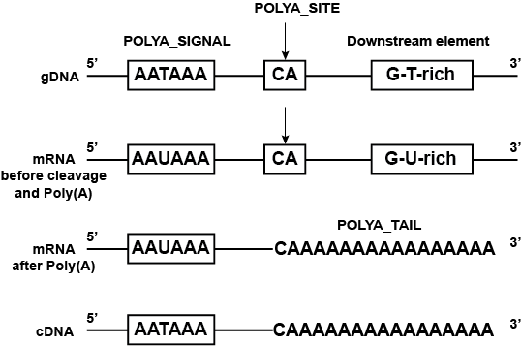

Slide 19
Pause/release mechanism: In some cases, transcription termination may involve a pausing of RNA polymerase II followed by its release from the DNA template. Factors involved in this process include the transcription termination factor TTF-I (Terminator-specific transcription factor I) and the RNA helicase Aquarius.
On the other hand, RNA polymerases I and III require termination signals. Genes transcribed by RNA polymerase I contain a specific 18-nucleotide sequence that is recognized by a termination protein resemble to rho dependent.
The process of termination in RNA polymerase III involves an mRNA hairpin similar to the rho-independent termination of transcription in prokaryotes.

Slide 20
Transcription in eukaryotic cells is fundamentally the same as that process in prokaryotic cells. Here we will point out some more key differences between the two.
Eukaryotic DNA is packaged into chromatin, which in the condensed state (default state) results in a promoter that is inaccessible to RNA polymerase. Transcription can only occur when DNA is decondensed and dissociated from the histones around which it is wound.
Transcription and translation cannot occur at the same time because eukaryotes have a separate compartment for the DNA (nucleus).
Prokaryotic cells: genes with common function are arranged linearly and are transcribed together on a single mRNA (polycistronic).

Slide 21
Eukaryotic mRNA is always monocistronic: one mRNA = one protein.
Eukaryotes have three types of RNA polymerase:
RNAP I: transcribes rRNA
RNAP II: transcribes mRNA
RNAP III: transcribes tRNA
Messenger RNA requires extensive modification before being translated into protein (maturing of RNA).
Promoters are more complex but also have a consensus sequence similar to that in prokaryotes. This is called the TATA box and is located about -30 nucleotides upstream of the transcriptional start site.
RNA polymerase needs the help of transcription factors to bind to DNA and start transcribing. Instead of a simple sigma factor, several transcription factors (TFs) bind to the promoter to recruit RNA Polymerase II

Slide 22
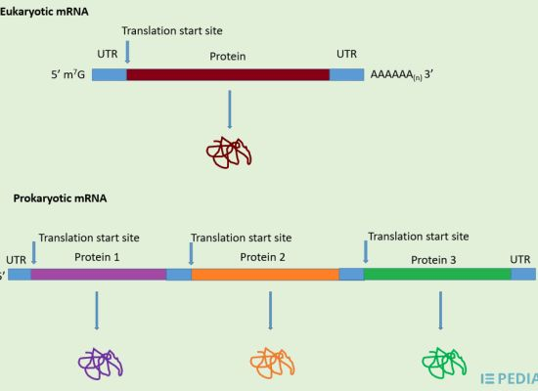

Slide 23
Post transcriptional modification
Post transcriptional modification, or co-transcriptional modification, is a series of biological processes common to most eukaryotic cells in which, following transcription from a gene, the primary RNA transcript is chemically altered to produce mature, functional RNA.
There are many types of post-transcriptional modifications achieved through diverse classes of molecular machinery.
One example is the conversion of a precursor messenger RNA transcript into a mature messenger RNA that can then be translated into protein. This process involves three major steps that drastically alter the chemical structure of the RNA molecule: capping , tailing , and RNA splicing.

