Slide 1
The Structure of Messenger
RNA Messenger RNA functions as the template for protein synthesis; it carries genetic information from DNA to a ribosome and helps to assemble amino acids in their correct order. Each amino acid in a protein is specified by a set of three nucleotides in the mRNA, called a codon. Both prokaryotic and eukaryotic mRNAs contain three primary regions .The 5' untranslated region (5' UTR; sometimes call the leader) is a sequence of nucleotides at the 5' end of the mRNA that does not code for the amino acid sequence of a protein

Slide 2
In bacterial mRNA, this region contains a consensus sequence called the Shine-Dalgarno sequence, which serves as the ribosome binding site during translation; it is found approximately seven nucleotides upstream of the first codon translated into an amino acid (called the start codon). Eukaryotic mRNA has no equivalent consensus sequence in its 5' untranslated region. In eukaryotic cells, ribosomes bind to a modified 5 end of mRNA,
The next section of mRNA is the protein-coding region, which comprises the codons that specify the amino acid sequence of the protein. The protein-coding region begins with a start codon AUG and ends with a stop codon UAA, UAG, and UGA It is also called open reading frame (ORF).

Slide 3
The last region of mRNA is the 3' untranslated region (3' UTR, or tailer sequence), a sequence of nucleotides at the 3' end of mRNA that is not translated into protein. The 3' untranslated region affects the stability of mRNA and the translation of the mRNA protein-coding sequence.
Untranslated regions or UTRs – They are present at 5’ and 3’ regions before and after the coding region, respectively. Untranslated regions are present before the start codon and after the stop codon. They have a role to play in gene expression. They are involved in the stability of RNA, the efficiency of translation and mRNA localisation.

Slide 4
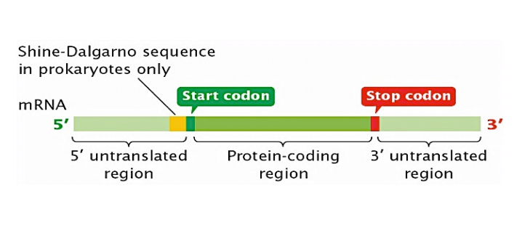

Slide 5
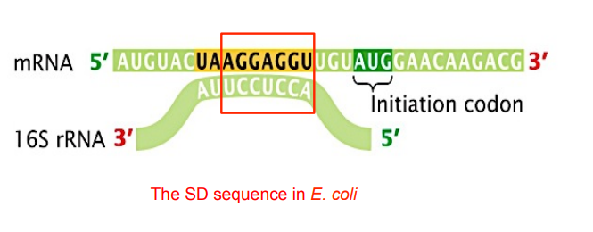

Slide 6
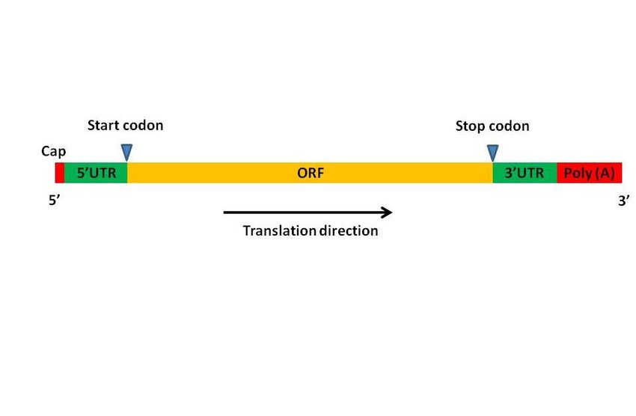
For the mRNA in Eukaryotic cell it start with cap structure at 5’ end then the leader sequence (un-translated region) followed by start codon then the coding region, at the 3’ end there is the poly A tail (250-300 Adenine residue ).

Slide 7
The Structure of Transfer RNA
A unique feature of tRNA is the occurrence of rare, modified bases. All RNAs have the four standard bases (adenine, cytosine, guanine, and uracil) specified by DNA, but tRNAs have additional bases, including ribothymine, pseudourasil (which is also occasionally present in snRNAs and rRNA), and dozens of others.
If there are only four bases in DNA, and all RNA molecules are transcribed from DNA, how do tRNAs acquire these additional bases? Modified bases arise from chemical changes made to the four standard bases after transcription. These changes are carried out by special tRNA-modifying enzymes. For example, the addition of a methyl group to uracil creates the modified base ribothymine

Slide 8
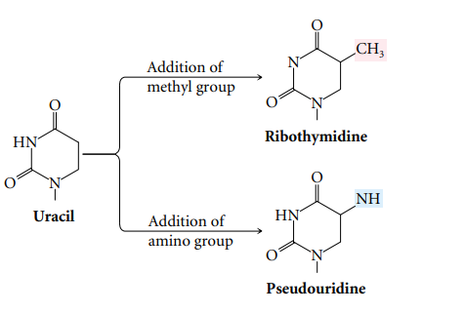

Slide 9
Most tRNAs contain between 74 and 95 nucleotides, some of which are complementary to each other and form intramolecular hydrogen bonds. As a result, each tRNA has a cloverleaf structure .
The cloverleaf has four major arms, each consisting of a stem and a loop. The stem is formed by the paring of complementary nucleotides, and the loop lies at the terminus of the stem, where there is no nucleotide pairing. If we start at the top and proceed clockwise around the tRNA the four major arms are the acceptor arm, the TΨC arm, the anticodon arm, and the DHU arm

Slide 10
The acceptor arm – Present at the 3’ end and carries amino acids. It has a terminal sequence of CCA (5’ -> 3’)
The anticodon loop – It contains a complementary codon(anti codon) for coding a specific amino acid it carries, during the translation process. And attaches to the codon on mRNA
D loop – Contains dihydrouridine
TψC loop – Contains pseudouridine
A small variable loop exists between the anticodon loop and the T arm.
Although each tRNA molecule folds into a cloverleaf owing to the complementary paring of bases, the cloverleaf is not the three-dimensional (tertiary) structure of tRNAs found in the cell. The results of X-ray crystallographic studies have shown that the cloverleaf folds upon itself to from an L-shaped structure, as illustrated by the space-filling and ribbon models .Notice that the acceptor stem is at one end of the tertiary structure and the anticodon is at the other end.

Slide 11
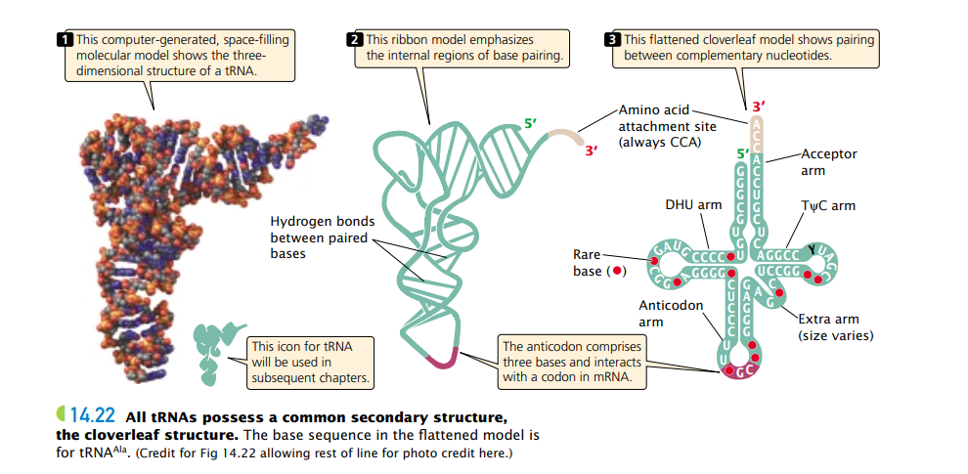

Slide 12
What is rRNA?
Ribosomal RNA (rRNA) serves as the foundational framework of the ribosome, a vital organelle orchestrating protein synthesis. Unlike messenger RNA (mRNA), which carries genetic instructions for protein assembly, rRNA is a non-coding RNA that facilitates the actual process within the ribosome.
Derived from ribosomal DNA (rDNA), rRNA collaborates with ribosomal proteins to construct the ribosome’s two main components: the large subunit (LSU) and the small subunit (SSU). Remarkably, despite its non-coding nature, rRNA dominates the cellular RNA landscape, constituting approximately 80% of total RNA.

Slide 13
Comprising approximately 60% rRNA and 40% protein, ribosomes possess distinct sedimentation coefficients, denoting their size and composition. In prokaryotes, the subunits are denoted as 50S (large) and 30S (small), housing three classes of rRNA: 5S, 23S, and 16S. Conversely, eukaryotic ribosomes are designated as 60S (large) and 40S (small), hosting four classes of rRNA: 5S, 5.8S, 28S, and 18S.

Slide 14
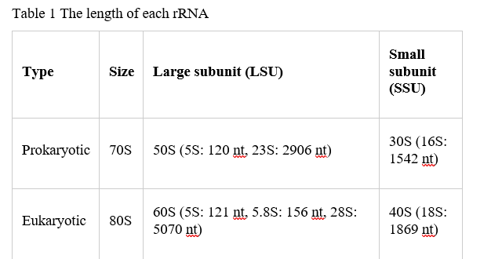

Slide 15
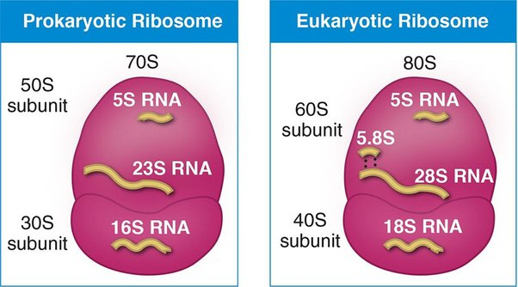

Slide 16
The term “16S rRNA” denotes “16S ribosomal ribonucleic acid,” with “S” representing Svedberg units, a measure of sedimentation rate .16S and 23S regions are commonly employed for microbial colony identification through amplicon sequencing, owing to their notable conservation and some variability.
They serve as effective markers for discerning genera and species present within microbial populations, facilitating assessments of their relative abundance.
What Does rRNA Do?
Catalyzing Protein Synthesis: rRNA acts as a catalyst for protein synthesis within the ribosome, ensuring the accurate assembly of amino acids into polypeptide chains.
Facilitating Ribosomal Functions: It plays a central role in ribosomal functions, including binding to messenger RNA (mRNA) to initiate translation and recruiting transfer RNA (tRNA) molecules carrying amino acids to the ribosome.

Slide 17
Structural Support: rRNA contributes significantly to the overall structure of the ribosome, accounting for approximately 60% of its weight. Its presence helps shape the ribosome and create specialized sites within it, such as the A (aminoacyl), P (peptidyl), and E (exit) sites.
Coordination of Protein Synthesis Steps: Within the ribosome, rRNA coordinates the sequential steps of protein synthesis. It guides the positioning of mRNA and tRNA molecules, facilitating the formation of peptide bonds between amino acids.
Binding to Ribosomal Proteins: rRNA contains binding sites for ribosomal proteins, aiding in the assembly and stability of the ribosome. These interactions contribute to the precise functioning of the ribosomal machinery.

Slide 18
