Slide 2
microRNA
A microRNA (miRNA) is a small non-coding RNA molecule, ranging typically from 21–25 nucleotides in length. miRNAs are widespread throughout the plant and animal kingdoms, and are found in some viruses. miRNAs are remarkably conserved in both plants and animals, and are thought to be a vital and evolutionarily ancient component of genetic regulation.
microRNAs regulate gene expression, thereby controlling many cellular processes including cell growth, differentiation, proliferation, and apoptosis. The specificity of miRNAs is dictated by only six to seven nucleotides of the 18-24 nt sequence. Therefore, a single miRNA can potentially target hundred of genes. Alterations in miRNAs expression have been correlated with disease pathogenesis. A number of diseases have been shown to have altered miRNA expression including multiple cancers, cardiovascular disease, and Alzheimer’s disease.

Slide 3
Discovery of miRNAs
miRNAs were first described in the journal Cell in 1993 by Lee et al. at Harvard University following their work in the model nematode, Caenorhabditis elegans.While studying postembryonic development in C. elegans, they made the fascinating discovery that lin-4, a gene previously known to negatively regulate the lin-14-encoded protein, did not actually encode a protein.
Instead, they found strong evidence that lin-4 encoded 2 short transcripts of approximately 22 and 61 nucleotides in length and that these transcripts contained sequences complementary to the 3-UTR (untranslated region) of lin-14 mRNA. These exciting observations suggested that lin-4 regulated lin-14 translation by an antisense RNA mechanism and for many years this type of antisense regulation was believed to be a phenomenon restricted to nematodes.

Slide 4
MiRNAs Aren’t Just for Nematodes
Fast forward 6 or 7 years, the second miRNA is found. let-7 was found to negatively regulate lin-41 mRNA to promote a later developmental transition in C. elegans. These findings were published in Nature by Reinhart et al. from Harvard Medical School, and soon afterwards the let-7 gene was found in a range of diverse organisms, prompting researchers to investigate the possible role for this new class of RNA molecules in developmental timing in humans.
In the years that followed, this class of novel RNAs had been extended to include many members, but expression profiling revealed that they were probably not involved in developmental regulation in humans, but were likely to be involved in other regulatory pathways. The term miRNA was coined by Gary Ruvkun in 2001, and the field of miRNA biology was officially born.

Slide 5
Approximately 2200 miRNA genes have been reported to exist in the mammalian genome, from which over 1000 belong to the human genome. Many major cellular functions such as development, differentiation, growth, and metabolism are known to be regulated by miRNAs.
Most miRNAs have an intracellular localization, but circulating miRNAs are detected in cell-free body fluids such as serum, blood, urine, and saliva Nowadays, many researchers are investigating the possibility of exploiting microRNA dysregulated expression profiles in the bloodstream of leukemic patients as a novel liquid biopsy diagnostic tool. Circulating miRNAs are stable molecules, detectable with high sensitivity and specificity, that could be used as new potential non-invasive biomarkers of both solid and hematologic neoplasms

Slide 6
miRNAs can be classified as intergenic, intronic or exonic miRNAs (intergenic miRNAs) depending on their genomic location and gene structure. Almost half of known miRNA genes are located in the intergenic region. These may exist either as a single gene or a cluster of genes under the control of their own promoters (Figure 2A).
Intronic miRNAs, are located in the introns of annotated genes, including both coding and non-coding genes. These intronic miRNA genes could be co-transcribed with their host genes or by their own miRNA-specific promoter. Mitronic miRNA are located and attached with two exons (Figure 2B). Exonic miRNAs are found overlapping across an exon and an intron of noncoding genes. This class of miRNAs is rare compared with the other two types (Figure 2C).

Slide 7
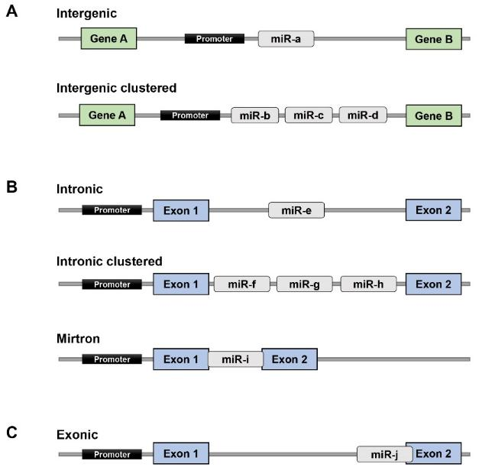

Slide 8
Canonical pathway for microRNAs biogenesis
Like other pol II transcripts, the primary transcripts (pri‐miRNAs) are capped and polyadenylated. Pri‐miRNAs contain a local stem–loop structure that encodes miRNA sequences in the arm of the stem. This stem–loop structure is cleaved by the nuclear RNase III type enzyme Drosha in a process known as ‘cropping’ .Drosha functions as a complex called ‘Microprocessor’ that also contains a double‐stranded RNA‐binding protein, DGCR8 (also known as Pasha in flies and nematodes) .The processing reaction releases the stem–loop‐shaped intermediates that are referred to as pre‐microRNAs (pre‐miRNAs).

Slide 9
Each pre‐miRNA is subsequently exported to the cytoplasm by exportin5‐,and in the cytoplasm these precursors are cleaved by the cytoplasmic RNase III Dicer . Dicer produces an RNA duplex of ∼22 nt, one strand of which is selected loaded onto Argonaute protein and incorporated into the effector complex known as the RNA‐induced silencing complex (RISC). RISC binds to the 3′ untranslated region (UTR) of the target mRNA in a sequence‐specific manner, and induces mRNA cleavage, translational inhibition and mRNA degredation .

Slide 10
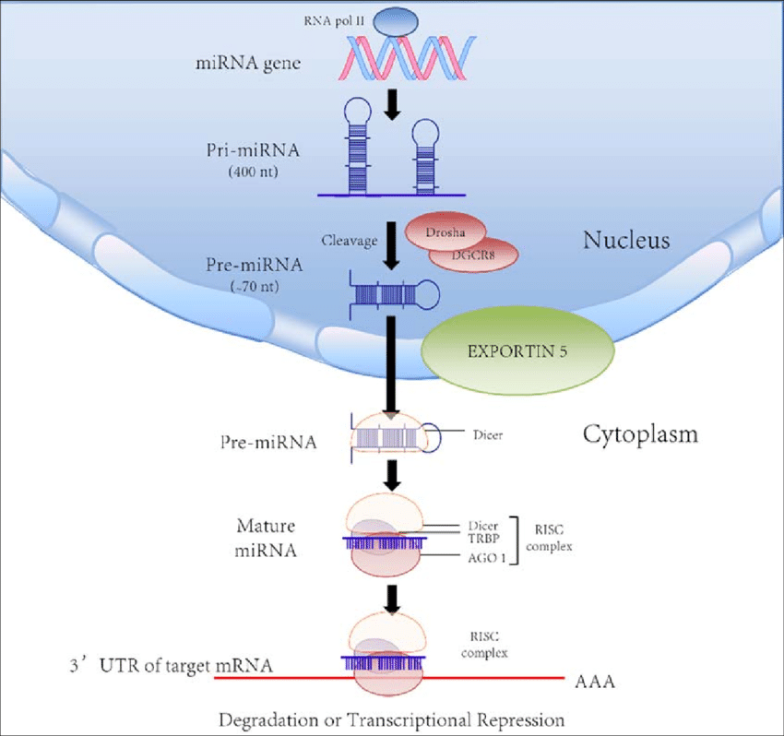

Slide 11
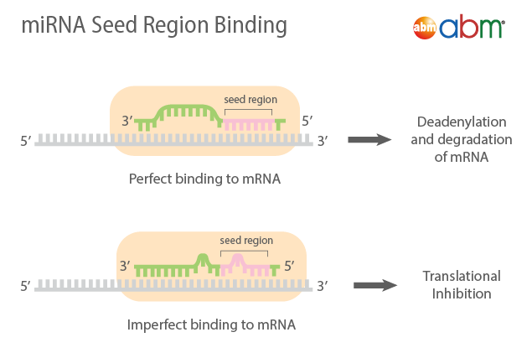
The seed region consists of nucleotides 2 to 8 on the 5’ end of the miRNA. The complementarity of the seed region to the mRNA determines how the gene will be silenced. If there is perfect complementarity between miRNA and mRNA it leads to degradation of the mRNA. If there is imperfect complementarity, it leads to inhibition of protein synthesis.

Slide 12
miRNA Nomenclature?
The first three letters indicate the organism the miRNA is found in. hsa = human, mmu = mouse, rno = rat. Capitalization indicates whether it is the mature or precursor miRNA. mir = precursor sequence, miR = mature sequence.
he prefix "miR" is followed by a dash and a number, .For example, miR-124 was named and likely discovered prior to miR-456.
Even more suffixes may be attached to the name to indicate closely related miRNAs. For example, hsa-miR-XXa and hsa-miR-XXb would indicate two miRNAs with very similar sequences (only one or two nucleotides different). .A numbered suffix is assigned to show mature miRNA sequences that are identical, but are transcribed from different genes and thus have a different precursor sequence. An example of this would be the precursor miRNAs hsa-mir-XX-1 and hsa-mir-XX-2, which would be processed into identical mature miRNAs called hsa-miR-XX-1 and hsa-miR-XX-2.

Slide 13
microRNA and cancer
it was reported that miRNAs are capable of regulating all the hallmarks of cancer . Therefore, as a tumor suppressor or as an oncomiR, various miRNAs can regulate tumorigenesis.Various hallmarks of cancer being regulated by miRNA . Dysregulation of miRNA in cancer can be due to epigenetic changes or alterations in miRNA biogenesis or polymorphism or mutation in the genes that code these miRNAs or chromosomal abnormalities. These can also happen conjointly, modulating the expression of miRNAs . The dysregulated miRNAs have been shown to affect the hallmarks of cancer, including sustaining proliferative signaling, evading growth suppressors, resisting cell death, enabling replicative immortality, inducing angiogenesis, and activating invasion and metastasis.

Slide 14
In terms of the mechanism, miRNAs act as oncogenic miRNA (oncomirs) and tumor suppressor miRNAs in tumorigenic events. In the function of tumor suppressor miRNAs, miRNAs are down-regulated, resulting in a potentially enhanced expression of oncogenes, promoting cell proliferation, migration, angiogenesis, invasion, and metastasis, whereas oncogenic miRNAs are over-expressed, leading to the inhibition of tumor suppressor genes, and, as a result, they increase the proliferation, migration and invasion of cancer cells as well as the loss of cell cycle regulation and they inhibit cell apoptosis.

Slide 15
