Slide 2
Classical Concept of Gene
Classical concept of gene was introduced by Sutton (1902) and which is outlined as follows.
I. Genes are discrete particles that occupies a definite locus (position) in the chromosome and responsible for expression of specific phenotypic character.
II. Number of genes in each organism is more than the number of chromosomes; hence several genes are located on each chromosome.
III. The genes are arranged in a single linear order like beads on a string.
IV. If the position of gene changes, character changes.
V. Genes can be transmitted from parent to off springs.

Slide 3
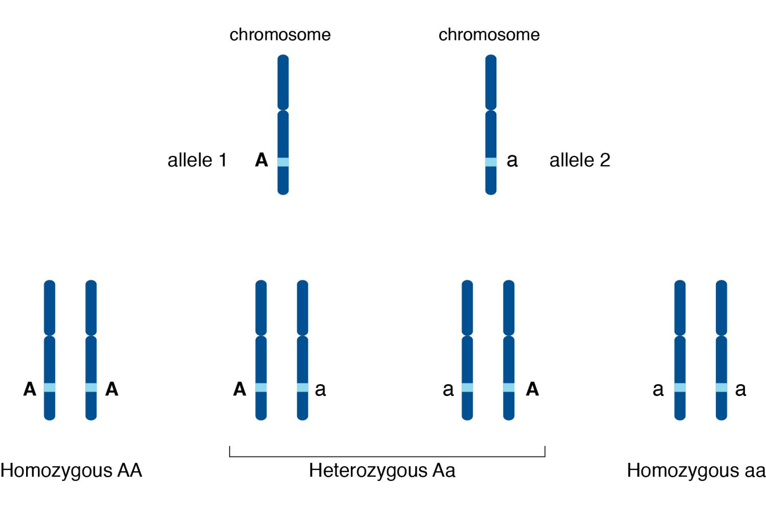
VI. Genes may exist in several alternate formed called alleles.
VII. Genes may undergo sudden change in position and composition called mutation.
VIII. Genes are capable of self duplication producing their own exact copies.

Slide 4
Modern Concept of Gene
S. Benzer (1957) coined different terms for different nature of gene and genetic material in relation to the chromosome on the basis of genetic phenomena to which they involve.
(i) Cistron: The part of DNA specifying a single polypeptide chain is termed as cistron.A cistron can have 100 nucleotide pairs in length to 30,000 nucleotide pairs. It transmits characters from one generation to other as unit of transmission.
(ii) Recon: The smallest segment of DNA capable of being separated and exchange with other chromosome is called recon.
(iii) Muton: Muton is the smallest unit of genetic material which when changed or mutated produce a different phenotypic trait. Thus, muton is delimited to a single nucleotide.

Slide 5
Types of the genes

Slide 6
House Keeping Genes
They are also known as constitutive genes. They constantly express themselves as they are needed to carry out basic cellular functions that occur continuously. In other words, they code for proteins that are continuously needed by the cell to perform basic cellular activities necessary for the maintenance of a cell.
So, they are always present and expressed in the cells under normal conditions. Thus, they are necessary for the existence of a cell irrespective of the role of a cell. Some examples of housekeeping genes are genes for glycolysis and genes of ATPase enzyme.

Slide 7
Non-constitutive Genes
These genes do not express themselves continuously in a cell. They are also called luxury genes or specialist genes. They can be switched on or off as per the requirement of cellular reactions or activities. Some examples include the gene required for nitrate reductase in plants and the gene for lactose system in E. coli.
They remain inactive or switched off for most of the time during the lifespan of an organism. They become active and express themselves in certain cells only when their products are needed.
They are further of two types: Inducible and repressible.

Slide 8
Inducible genes: These type of non-constitutive genes are switched on or becomes active in response to the presence of a chemical or inducer that is needed for the functioning of the product of these gene's activity. For example, nitrate for nitrate reductase.
Repressible genes: They keep expressing themselves until their activity is inhibited or repressed by a chemical or an end product. The inhibition of this gene's activity by an end product is called feedback repression. For example, trp genes are repressed by tryptophan.

Slide 9
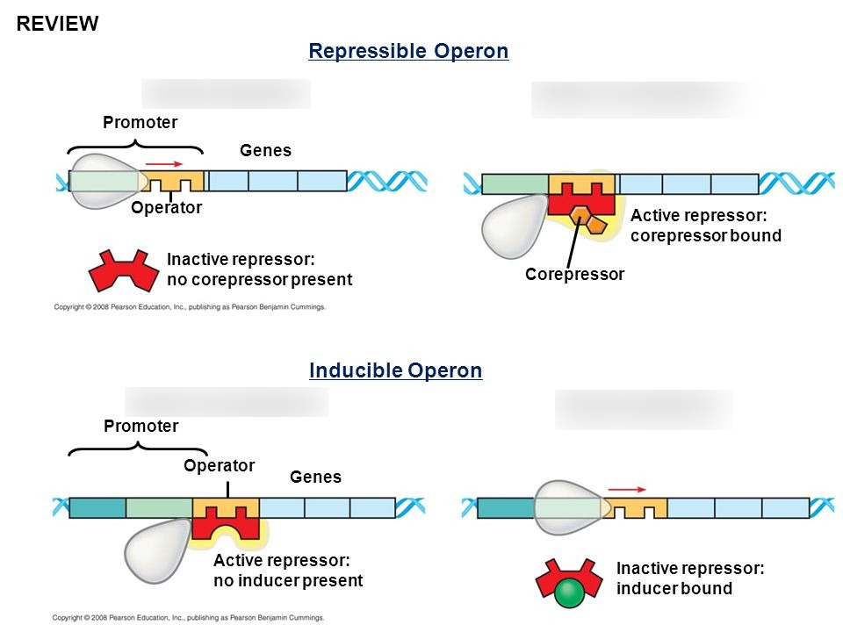

Slide 10
Structural Genes (Cistrons)
They are also called cistrons as they are protein-coding genes which means they code only for proteins not for any type of RNA or any other product. They are a continuous stretch of DNA that contains the protein coding sequences exons (ORF) and non-coding sequences that are called introns.
These sequences are present repeatedly and alternatively inside the cistron.
They code for the synthesis of chemical substances or protein for a specific morphological and functional trait of the cell. The structural gene remains under the control of regulator gene, operator gene and promoter gene

Slide 11
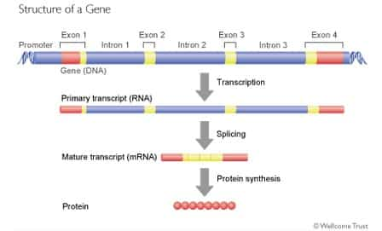

Slide 12
Pseudogenes
They are similar or homologous to functional protein-coding genes, but they cannot produce a functional protein due to disordered open reading frame (ORF). Similarly, they may be highly similar to RNA encoding genes but cannot produce an RNA transcript.
So, they are non-functional genomic sequences that resemble functional genes but are not able to produce functional products due to nonsense codon, deletions, insertions and deactivation of promoter regions.

Slide 13
Transposons (Jumping Genes)
As the name suggests, they are those genes or segments of DNA that can jump or move from one place in the genome to another place; from one chromosome to another chromosome within the genome of an individual. Jumping genes were first discovered by Nobel Prize winner Mc Clintock (1951) in Maize when she observed that a DNA segment can jump from one location to another within the genome of a cell. They are mostly present towards the telomeric region of the chromosome.
Besides this, they do not code for a protein. They can only jump or discontinue themselves from a particular region of the chromosome generally from the end region of the chromosome and can ligate themselves to another chromosome.

Slide 14
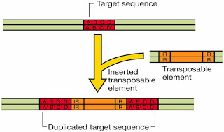

Slide 15
Split genes
They were discovered by Sharp and Roberts. They were awarded the Nobel Prize in 1993. It is a gene that contains a non-functional part along with the functional part. They possess extra or non-essential part interspersed with the essential or coding part. So, they have intervening sequences that do not code for a protein. The non-functional part is called introns or spacer DNA or intervening sequences (IVS) and functional parts are called exons. Introns are removed before RNA passes out into the cytoplasm. They are also known as interrupted genes.

Slide 16
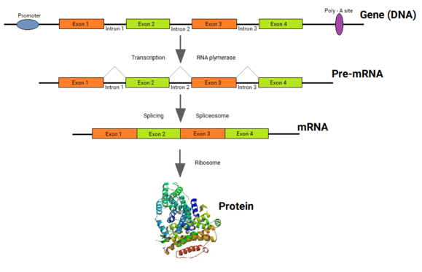

Slide 17
Regulator gene
It controls another gene. They turn on or off the transcription of structural genes. It controls the expression of structural genes of an operon through the synthesis of a repressor protein.
They code for repressor protein and are present upstream to the coding sequence of cistron or structural gene. They produce a repressor mRNA which translates a particular repressor protein that binds to the operator region which is present next to the regulator gene in a cistron. So, if the repressor gene binds with the operator gene, automatically the cistron will remain switched off and will not express.

Slide 18
Operator gene
This gene acts as a switch, for example, if the repressor protein produced by the regulator gene binds in the operator region, it (operator gene) remains switched off and it does not allow the mRNA polymerase enzyme to move forward and transcribe the structural gene of cistron so it acts as a switch to turn on or off the transcription of the cistron.
. Promoter gene
Promotor gene is present upstream (towards the starting point) to the cistron's structural gene. It must be present and active only then the cistron will work or express itself. It provides the site for the binding of RNA polymerase enzyme which binds to the promoter region of the cistron so that it can scan the nucleotides of the structural genes and can transcribe the mRNA. So, promoter gene is the site where the RNA polymerase bind.

Slide 19
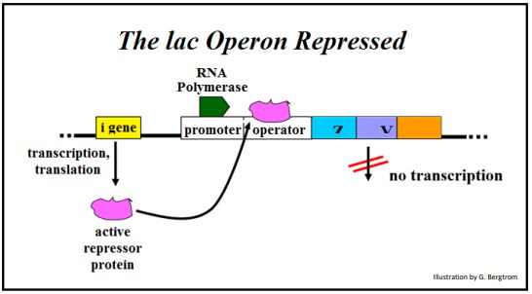

Slide 20
Terminator gene
This gene (a segment or part of DNA) is present towards the downstream of the cistron where transcription terminates and where RNA polymerase enzyme dissociates from DNA. So, it is a DNA site where RNA polymerase activity stops and transcription terminates.
Integrated gene
They can be present in different chromosomes or different parts of a single chromosome. All these genes are activated simultaneously whey they are supposed to involve in a particular biochemical pathway which involves 10 or more enzymes. So, there must be 10 or more proteins for 10 or more enzymes and similarly, there must be 10 or more number of cistrons to produce the required number of proteins. So all these cistrons are protein-coding genes that are switched on simultaneously when the metabolic pathway is going on.

Slide 21
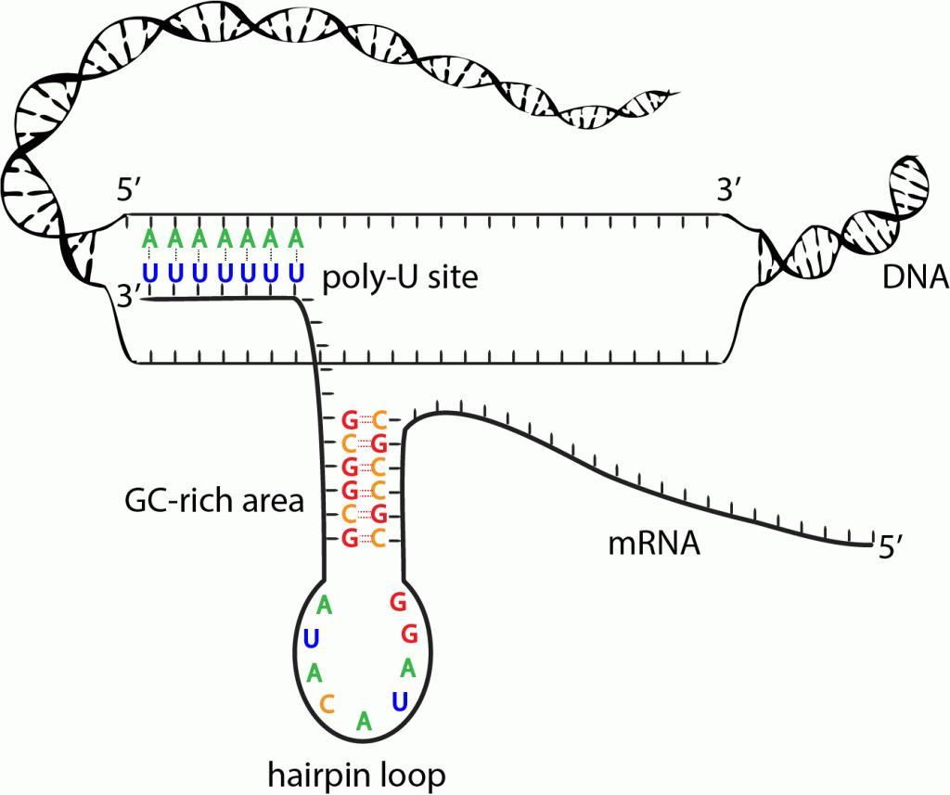

Slide 22
RNA Polymerase
RNA polymerase being the key enzyme in transcription, it is worthwhile to study the details of its structure and mode of its action. A single type of RNA polymerase is responsible for synthesis of m-RNA, r-RNA and t-RNA in bacteria. However, in eukaryotes several different enzymes are required to synthesis the different types of RNA. They are called as:
• RNA polymerase I, is responsible for synthesis of rRNA (ribosomal).
• RNA polymerase II, is the main enzyme synthesizing mRNAs.
• RNA polymerase III, is responsible for production of tRNA

Slide 23
Action of RNA Polymerase
1- Like DNA polymerases, RNA polymerases catalyze the formation of ester bonds between nucleotides that base-pair with the complementary nucleotides on the DNA template.
2- RNA polymerases differ from DNA polymerases in that they can initiate the synthesis of new strands in the absence of a primer.
3- In addition to catalyzing the polymerization of ribonucleotides, RNA polymerases must be able to recognize:
a- the appropriate gene to transcribe
b- the appropriate strand of the double-stranded DNA to copy,
c- and the start point of transcription
d- control the frequency of transcription.

