Slide 1
DNA sequencing

Slide 2
DNA-Sequencing Methods
The first methods for quickly sequencing DNA were developed between 1975 and 1977. Frederick Sanger and his colleagues created the dideoxy sequencing method based on the elongation of DNA; Allan Maxam and Walter Gilbert developed a second method based on the chemical degradation of DNA. The Sanger method quickly became the standard procedure for sequencing any purified fragment of DNA.
The Sanger, or dideoxy, method of DNA sequencing is based on the process of replication. The fragment to be sequenced is used as a template to make a series of new DNA molecules. In the process, replication is sometimes (but not always) terminated when a specific base is encountered, producing DNA strands of different length, each of which ends in the same base.

Slide 3
The method relies on the use of a special substrate for DNA synthesis. Normally, DNA is synthesized from deoxyribonucleoside triphosphates (dNTPs), which have an OH group on the 3`carbon atom ( FIGURE 19.5a). In DNA synthesis, two phosphate groups on the 5`carbon atom of a dNTP are removed, and a phosphodiester bond is formed between the remaining 5`phosphate group of the dNTP and the 3`OH group of the last nucleotide on the growing DNA chain.
In the Sanger method, a special nucleotide, called a dideoxyribonucleoside triphosphate (ddNTP; FIGURE 19.5b), is used as substrate. The ddNTPs are identical with dNTPs,except that they lack a 3` OH group. Like dNTPs, ddNTPs possess three phosphate groups on their 5` ends, and so they are incorporated into a growing DNA chain. When a ddNTP has been incorporated into a DNA chain, however, no more nucleotides can be added, because there is no 3` OH group to form a phosphodiester bond with an incoming nucleotide. Thus, ddNTPs terminate DNA synthesis.

Slide 4
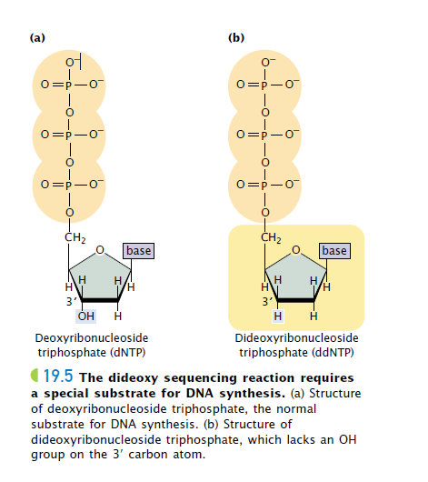

Slide 5
A single DNA molecule cannot be sequenced; so any DNA fragment to be sequenced must first be amplified by PCR or by cloning in bacteria. Copies of the target DNA are isolated and split into four parts ( FIGURE 19.6). Each part is placed in a different tube, to which are added:
1. Copies of a primer that is complementary to one end of the target DNA strand;
2. All four deoxyribonucleoside triphosphates (dCTP, dATP, dGTP, and dTTP), the normal precursors of DNA synthesis;
3. Asmall amount of one of the four types of dideoxyribonucleoside triphosphates (ddCTP, ddATP, ddGTP, or ddTTP), which will terminate DNA synthesis as soon as it is incorporated into any growing chain (each of the four tubes received a different ddNTP); and
4. DNA polymerase.
Either the primer or one of the dNTPs is radioactively or chemically labeled so that newly produced DNA can be detected.

Slide 6
Within each of the four tubes, the DNA polymerase enzyme carries out DNA synthesis. Let’s consider the reaction in one of the four tubes; the one that received ddATP. Within this tube, each of the single strands of target DNA serves as template for DNA synthesis.
The primer pairs to its complementary sequence at one end of each template strand, providing a 3`OH group for the initiation of DNA synthesis. DNA polymerase elongates a new strand of DNA from this primer, by using the target DNA strand as a template. Wherever DNA polymerase encounters a T on the template strand, it uses at random either a dATP or a ddATP to introduce an A in the newly synthesized strand.

Slide 7
Because there is more dATP than ddATP in the reaction mixture, dATP is incorporated most often, allowing DNA synthesis to continue. Occasionally, however, ddATP is incorporated into the strand and synthesis terminates. The incorporation of ddATP into the new strand occurs randomly at different positions in different copies, producing a set of DNA chains of different length (12, 7, and 2 nucleotides long in the example illustrated in Figure 19.6), each ending in a nucleotide with adenine.
Equivalent reactions take place in the other three tubes.
In the tube that received ddCTP, all the chains terminate in a nucleotide with cytosine; in the tube that received ddGTP, all the chains terminate in a nucleotide with guanine; and, in the tube that received ddTTP, all the chains terminate in a nucleotide with thymine. After the completion of the polymerization reactions, all the DNA in the tubes is denatured, and the single-strand products of each reaction are separated by gel electrophoresis.

Slide 8
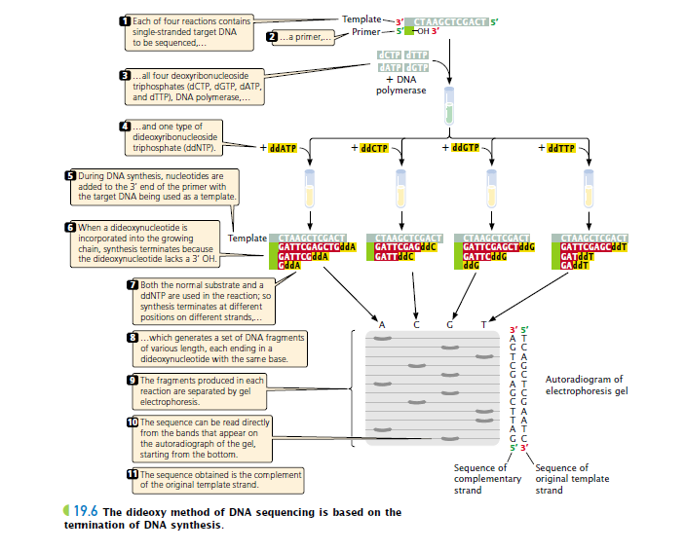

Slide 9
The contents of the four tubes are separated side by side on an acrylamide gel so that DNA strands differing in length by only a single nucleotide can be distinguished. After electrophoresis, the locations of the DNA strands in the gel are revealed by autoradiography.
The shortest strands, which terminated at positions early in the DNA sequence, migrate quickly and end up near the bottom of the gel; longer fragments, which terminated late in the sequence, migrate more slowly and end up near the top of the gel.

Slide 10
Reading the DNA sequence is simple and the shortest part of the procedure. In Figure 19.6, you can see that the band closest to the bottom of the gel is from the tube that contained the ddGTP reaction, which means that the first nucleotide synthesized had guanine (G). The next band up is from the tube that contained ddATP; so the next nucleotide in the sequence is adenine (A), and so forth.

Slide 11
In this way, the sequence is read from the bottom to the top of the gel, with the nucleotides near the bottom corresponding to the 5` end of the newly synthesized DNA strand and those near the top corresponding to the 3` end. Keep in mind that the sequence obtained is not that of the target DNA but that of its complement.

Slide 12
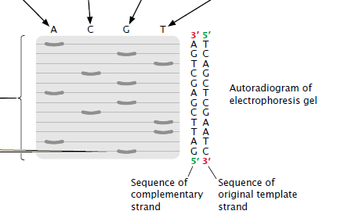

Slide 13
Sequencing is often carried out by automated machines that use fluorescent dyes and laser scanners to sequence thousands of base pairs in a few hours ( FIGURE 19.8). The dideoxy reaction is also used here, but the ddNTPs used in the reaction are labeled with a fluorescent dye, and a different colored dye is used for each type of dideoxynucleotide. For example, a red dye might be used for nucleotides with thymine, a green dye for those with adenine, a black dye for those with guanine, and a blue dye for those with cytosine.

Slide 14
In this case, the four sequencing reactions can take place in the same test tube and can be placed in the same well during electrophoresis, given that each ddNTP is distinctively marked. The most recently developed sequencing machines carry out electrophoresis in gel-containing capillary tubes.

Slide 15
The different-sized fragments produced by the sequencing reaction separate within a tube and migrate past a laser beam and detector. As the fragments pass the laser, their fluorescent dyes are activated and the resulting fluorescence is detected by an optical scanner. Each colored dye emits fluorescence of a characteristic wavelength, which is read by the optical scanner. The information is fed into a computer for interpretation, and the results are printed out as a set of peaks on a graph (See Figure 19.8). Automated sequencing machines may contain 96 or more capillary tubes, allowing from 50,000 to 60,000 bp of sequence to be read in a few hours.

Slide 16
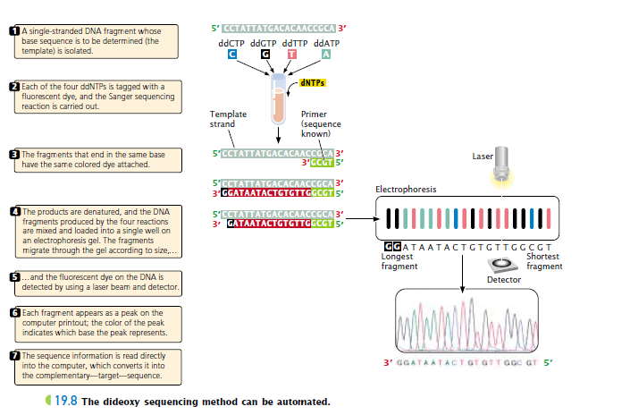

Slide 17
What is Next-Generation Sequencing (NGS)
Next-generation sequencing (NGS) is a technology for determining the sequence of DNA or RNA to study genetic variation associated with diseases or other biological phenomena. Introduced for commercial use in 2005.
This method was initially called “massively-parallel sequencing”, because it enabled the sequencing of many DNA strands at the same time, instead of one at a time as with traditional Sanger sequencing by capillary electrophoresis (CE).
Sanger sequencing is best for analyzing small numbers of gene targets and samples and can be accomplished in a single day.

Slide 18
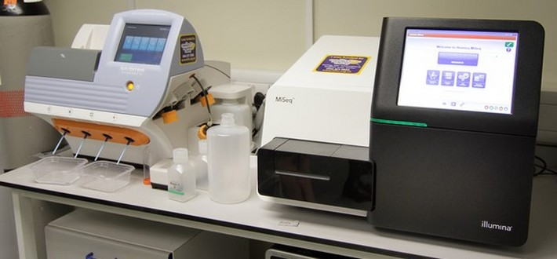

Slide 19
It is also considered the gold-standard sequencing technology, so NGS results are often verified using Sanger sequencing. NGS enables the interrogation of hundreds to thousands of genes at one time in multiple samples, as well as discovery and analysis of different types of genomic features in a single sequencing run, from single nucleotide variants (SNVs), to copy number and structural variants, and even RNA fusions.
NGS provides the ideal throughput per run, and studies can be performed quickly and cost-effectively. Additional advantages of NGS include lower sample input requirements, higher accuracy, and ability to detect variants at lower allele frequencies than with Sanger sequencing.
the speed, throughput, and accuracy of NGS has revolutionized genetic analysis and enabled new applications in genomic and clinical research, reproductive health, and environmental, agricultural, and forensic science.

Slide 20
Next-Generation Sequencing workflow
1. Construct library
A sequencing “library” must be created from the sample. The DNA (or cDNA) sample is processed into relatively short double-stranded fragments (100–800 bp). Depending on the specific application, DNA fragmentation can be performed in a variety of ways, including physical shearing, and enzyme digestion.
Clonal amplification
Prior to sequencing, the DNA library must be attached to a solid surface and clonally amplified to increase the signal that can be detected from each target during sequencing. During this process, each unique DNA molecule in the library is bound to the surface of a bead or a flow-cell and PCR amplified to create a set of identical clones.

Slide 22
Sequence library
All of the DNA in the library is sequenced at the same time using a sequencing instrument.
Analyze data
Each NGS experiment generates large quantities of complex data consisting of short DNA reads. Analysis can be divided into three steps: primary, secondary, and tertiary analysis. Primary analysis is the processing of raw signals from instrument detectors into digitized data . Secondary analysis involves read filtering and trimming based on quality, followed by alignment of reads to a reference genome . Tertiary analysis is the most challenging step, as it involves interpreting results and extracting meaningful information from the data.

