Slide 1
4- Dispersion and Variances

Slide 2
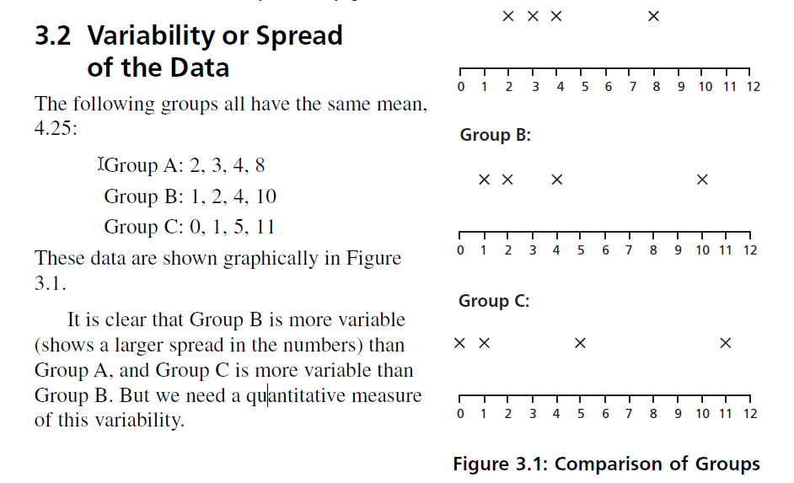

Slide 3
First Quartile and Third Quartile
• The lower half of a data set is the set of all values that are to the left of the median value when the data has been put into increasing order.
• The upper half of a data set is the set of all values that are to the right of the median value when the data has been put into increasing order.
• The first quartile, denoted by Q1 , is the median of the lower half of the data set. This means that about 25% of the numbers in the data set lie below Q1 and about 75% lie above Q1 .
• The third quartile, denoted by Q3 , is the median of the upper half of the data set. This means that about 75% of the numbers in the data set lie below Q3 and about 25% lie above Q3 .

Slide 4
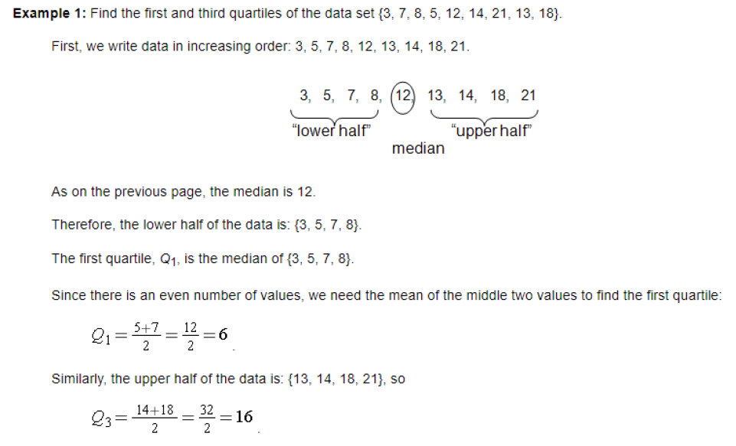

Slide 5
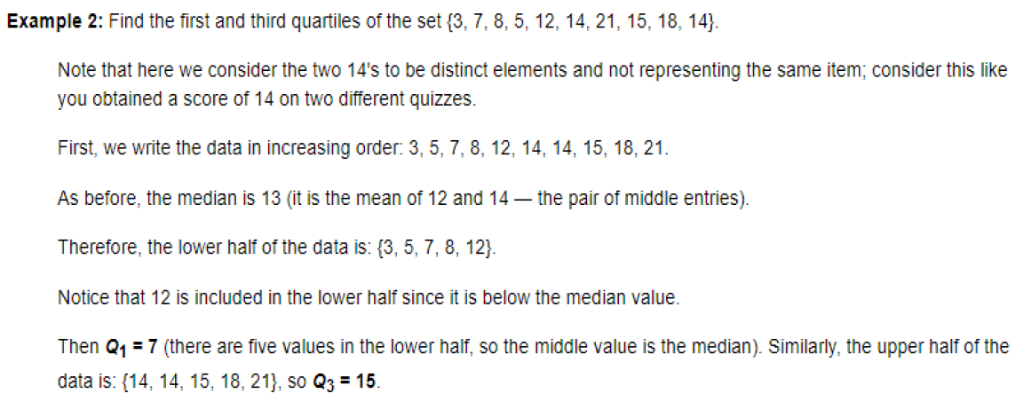

Slide 6
Decile and Percentile
They are locations (values) which divide the set of values (after arranging them increasingly or decreasingly).
For example, the third decile is the value that divides the set of values into two parts, 3/10 is before and 7/10 is after.
Or the seventieth percentile, is the values that divides the set of values into two parts, 70% is before and 30% is after.

Slide 7
Example: for the frequency distribution table, find:
1-First and Third quartiles (Q1)
2-6th decile.
3-fortieth percentile.
$$Q_{1}=L_{1}+\left(\frac{\frac{Σf}{4}−F_{Q1−1}}{f_{Q1}}\right)⋅c$$
L₁=lower boundaries for first quartile class
F_{Q1-1}=cumulative frequency of the class before first quartile class
f_{Q1}=frequency of first quartile class
C=length of classes
Note: the First Quartile Class is the interval in which the first quartile item (N/4) lies.

Slide 8
“less than”
Solution:
Classes | f | F (cum. f)
60-63 | 5 | 5
63-66 | 18 | 23
66-69 | 42 | 65
69-72 | 27 | 92
72-75 | 8 | 100
total | 100
1- Q₁:
First Quartile Class
$$\frac{N}{4}=\frac{Σf}{4}=\frac{100}{4}=25$$
$$Q_{1}=66+\left(\frac{25−23}{42}\right)⋅3$$
$$Q_{1}=66.143$$

Slide 9
“less than”
Solution:
Classes | f | F (cum. f)
60-63 | 5 | 5
63-66 | 18 | 23
66-69 | 42 | 65
69-72 | 27 | 92
72-75 | 8 | 100
total | 100
2- 6th decile:
6th decile Class
$$\frac{6}{10}∗100=60$$
$$\text{6}\text{th} \text{decile}=66+\left(\frac{60−23}{42}\right)⋅3$$
$$\text{6}\text{th} \text{decile}=68.643$$

Slide 10
“less than”
Solution:
Classes | f | F (cum. f)
60-63 | 5 | 5
63-66 | 18 | 23
66-69 | 42 | 65
69-72 | 27 | 92
72-75 | 8 | 100
total | 100
3- 40th percentile:
40th percentile Class
$$\frac{40}{100}∗100=40$$
$$\text{40}\text{th} \text{percent}\text{ile}=66+\left(\frac{40−23}{42}\right)⋅3$$
$$\text{4}\text{0}\text{th} \text{percent}\text{ile}=67.214$$

Slide 11
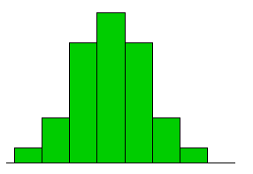
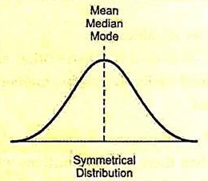
Relationship between Mean, Median and Mode
Symmetrical Distribution: A distribution is said to be symmetrical when the values of mean, median and mode are equal. There is equal number of values on both sides of the mean which means the values occur at regular frequencies.

Slide 12
When the values of mean, median and mode are not equal, then the distribution is said to be asymmetrical or skewed. A skewed distribution can either be positively skewed or negatively skewed. Histograms in case of skewed distribution would be as shown
positive skew
negative skew

Slide 13
MEASURES OF DISPERSION
1- Range :The difference between the largest and smallest values in a set of date.
Example: The mean of the following data in section A and B is equal to 19. Determine the range for both sections.
Section A : 6 9 11 13 15 21 23 28 29 35
Section B: 15 16 16 17 18 19 20 21 23 25
The range for Section A = 35 - 6 = 29
The range for Section B = 25 – 15 = 10

Slide 14
2- Mean deviation
Let us take the deviation of each observation from the mean and add all such deviations. If the sum is 'large', the dispersion is 'large'. If, however, the sum is 'small' the dispersion is small.
Section A : 6 9 11 13 15 21 23 28 29 35
Section B: 15 16 16 17 18 19 20 21 23 25
Section A
Here, the sum is zero. It is neither 'large' nor 'small'. Is it a coincidence ?

Slide 15
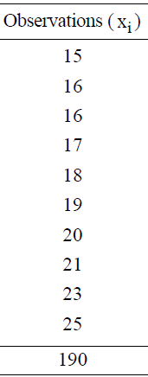
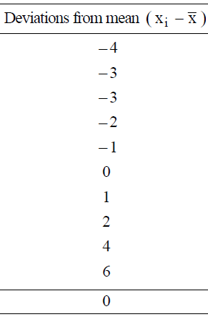
Section B
Again, the sum is zero. Certainly it is not a coincidence.
In fact, the sum of the deviations taken from the mean is always zero for any set of data.

Slide 16
we get sum of deviations to be zero, so, we cannot draw any conclusion from the sum of deviations. But this can be avoided if we take only the absolute value of the deviations and then take their sum.
If we follow this method, we will obtain a measure (descriptor) called the mean deviation from the mean.
Mean deviation: The mean deviation is the sum of the absolute values of the deviations from the mean divided by the number of items, (i.e., the sum of the frequencies).

Slide 17
Mean Deviation (M.D)
$$M⋅D=\frac{\sum{f_{i}\left|x_{i}−\overline{χ}\right|}}{\sum{f_{i}}}$$

Slide 18
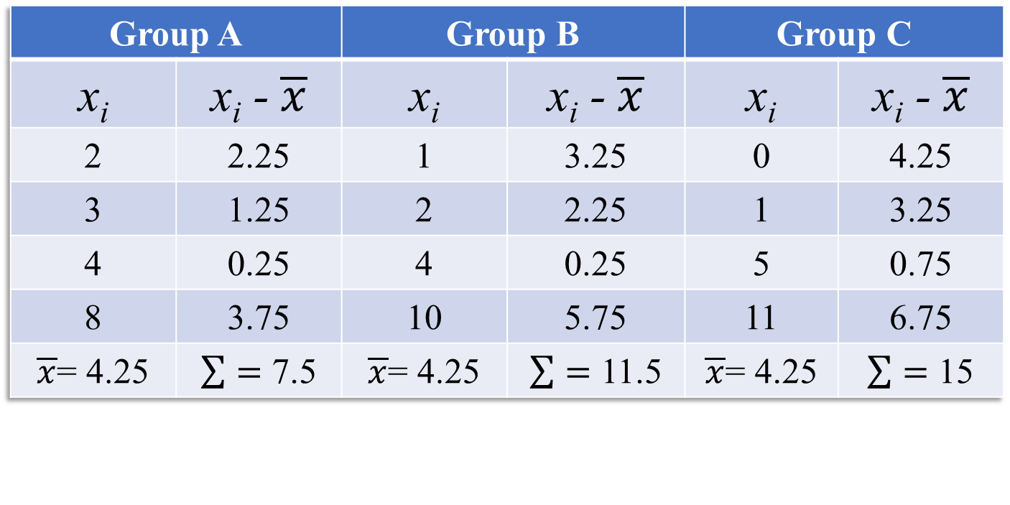
Example: Find the mean deviation from the mean of the following data. Group A: 2, 3, 4, 8
Group B: 1, 2, 4, 10
Group C: 0, 1, 5, 11
Solution:
Group A |  | Group B |  | Group C
x_{i} | x_{i} - $\overline{x}$ | x_{i} | x_{i} - $\overline{x}$ | x_{i} | x_{i} - $\overline{x}$
2 | 2.25 | 1 | 3.25 | 0 | 4.25
3 | 1.25 | 2 | 2.25 | 1 | 3.25
4 | 0.25 | 4 | 0.25 | 5 | 0.75
8 | 3.75 | 10 | 5.75 | 11 | 6.75
$\overline{x}$= 4.25 | $\sum{=}$ 7.5 | $\overline{x}$= 4.25 | $\sum{=}$ 11.5 | $\overline{x}$= 4.25 | $\sum{=}$ 15
M.D. = 1.875
M.D. = 2.875
M.D. = 3.75

Slide 19
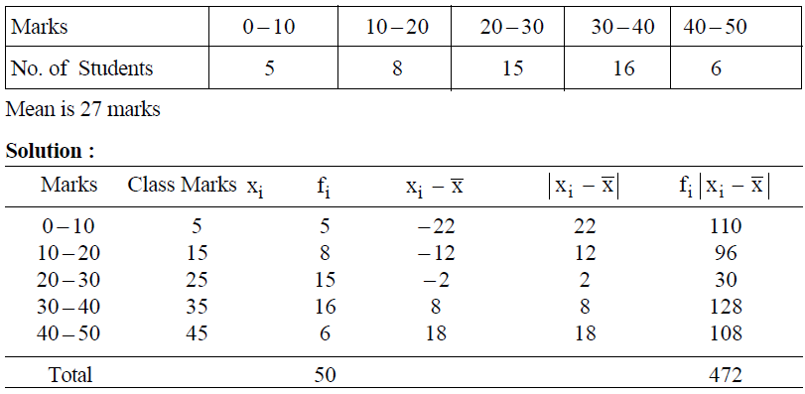
Example: Calculate the mean deviation from mean of the following distribution :

Slide 20
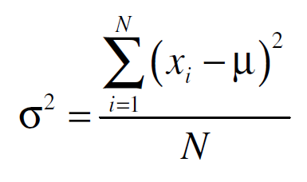
3- Variance :
In the above case, we took the absolute value of the deviations taken from mean to get rid of the negative sign of the deviations. Another method is to square the deviations. Let us, therefore, square the deviations from the mean and then take their sum. If we divide this sum by the number of observations (i.e., the sum of the frequencies), we obtain the average of deviations, which is called variance.
Variance is the mean of the squares of the deviations of each measurement from the mean of the population. It is usually denoted by s².
μ = the mean of the entire population. σ² = the variance of the population.

Slide 21
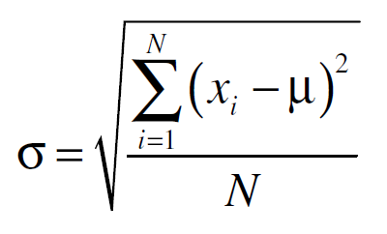
3- Standard Deviation :
The standard deviation is extremely important. It is defined as the square root of the variance:

Slide 22
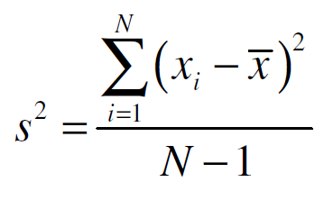
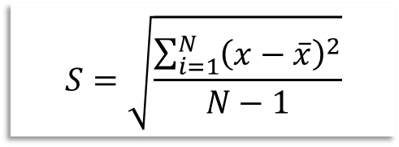
Estimation of Variance and Standard Deviation from a Sample
When we calculate the results from a sample (i.e., a part of the
population) we do not usually know the population mean, so we must find a way to use the sample mean, which we can calculate.
S² = sample variance
$$S=\sqrt{\frac{\sum_{i=1}^{N}{{\left(x−\overline{x}\right)}^{2}}}{N−1}}$$
S = sample standard deviation
For data organized in frequency distribution table
$$S^{2}=\frac{\sum_{i=1}^{N}{f_{i}{\left(x_{i}−\overline{x}\right)}^{2}}}{\sum_{i=1}^{N}{f_{i}−1}}$$

Slide 23
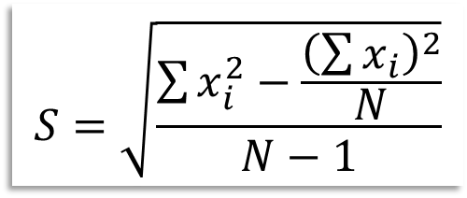
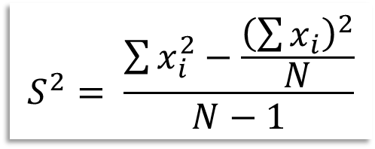
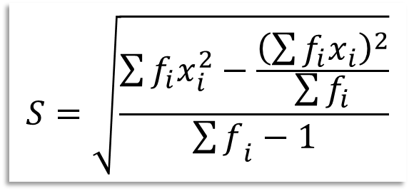
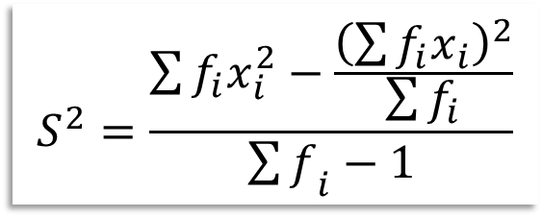
for Faster Calculation
$$S^{2}= \frac{\sum{x_{i}^{2}−\frac{{\left(\sum{x_{i}}\right)}^{2}}{N}}}{N−1}$$
$$S=\sqrt{\frac{\sum{x_{i}^{2}−\frac{{\left(\sum{x_{i}}\right)}^{2}}{N}}}{N−1}}$$
and
For a set of values where x_{i} represents the class mid-point in frequency distribution table.
$$S^{2}=\frac{\sum{f_{i}x_{i}^{2}−\frac{{\left(\sum{f_{i}x_{i}}\right)}^{2}}{\sum{f_{i}}}}}{{\sum{f}}_{i}−1}$$
$$S=\sqrt{\frac{\sum{f_{i}x_{i}^{2}−\frac{{\left(\sum{f_{i}x_{i}}\right)}^{2}}{\sum{f_{i}}}}}{{\sum{f}}_{i}−1}}$$
and

Slide 24
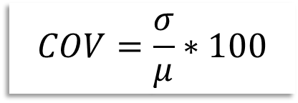
4- Coefficient of Variation.
A dimensionless quantity, the coefficient of variation is the ratio between the standard deviation and the mean for the same set of data, expressed as a percentage. This can be either (σ / μ) or (s / $\overline{x}$ ), whichever is appropriate, multiplied by 100%.
$$COV=\frac{σ}{μ}∗100$$
For population
$$COV=\left(S/{\overline{x}}\right)∗100$$
For sample

Slide 25
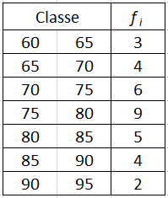
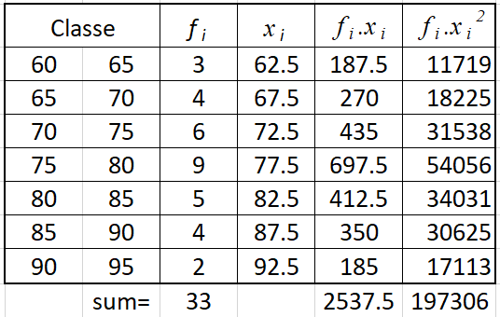
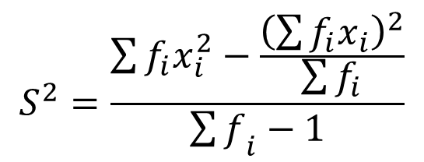
Example: Compute variance and standard deviation for the data shown in frequency distribution table.
Solution:
$$S^{2}=\frac{\sum{f_{i}x_{i}^{2}−\frac{{\left(\sum{f_{i}x_{i}}\right)}^{2}}{\sum{f_{i}}}}}{{\sum{f}}_{i}−1}$$
$$S^{2}=\frac{197306−\frac{{2537.5}^{2}}{33}}{33−1}=68.37$$

