Slide 1
Chapter 9
Correlation and Regression
Simple Linear Regression
24 January 2024

Slide 2
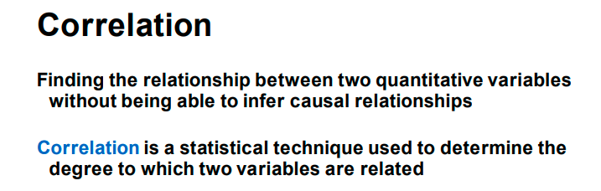

Slide 3
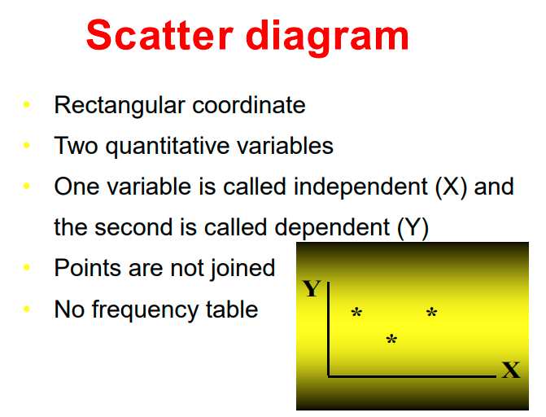

Slide 4
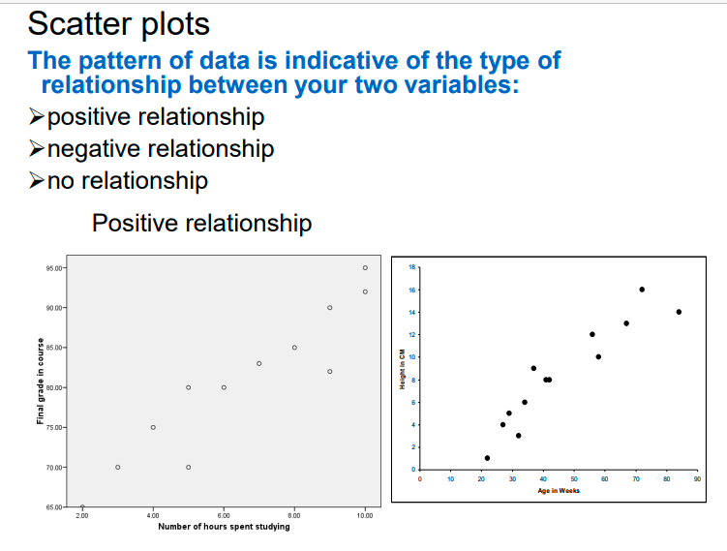

Slide 5
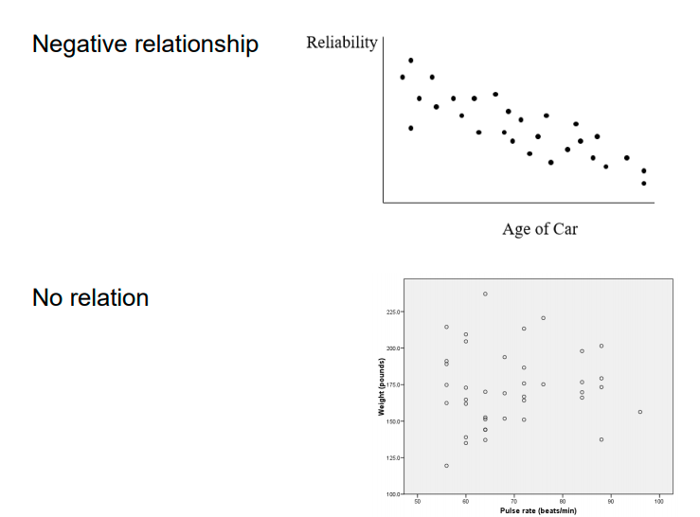

Slide 6
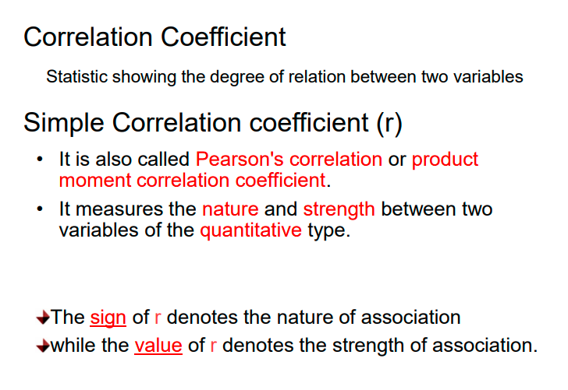

Slide 7
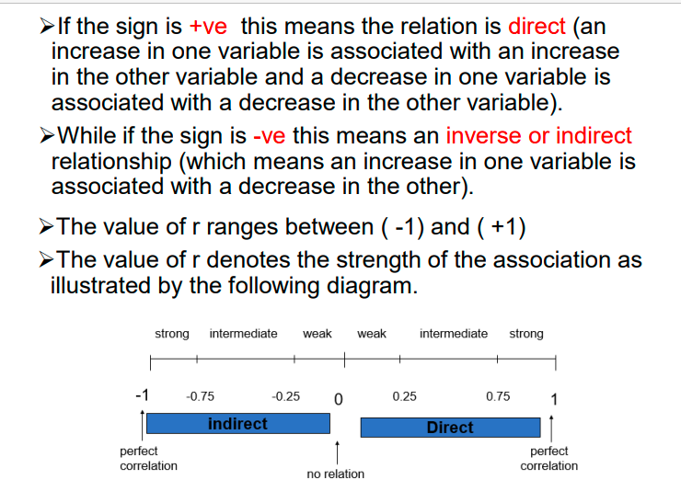

Slide 8
Regression
Using regression analysis, we can derive an equation by which the dependent variable (Y) is expressed (and estimated) in terms of its relationship with the independent variable (X).
  In simple regression, there is only one independent variable (X) and one dependent variable (Y). The dependent variable is the outcome we are trying to predict.
  In multiple regression, there are several independent variables (X1, X2, … ), and still only one dependent variable, Y. We are trying to use the X variables to predict the Y variable.
We will be studying Simple Linear Regression, in which we investigate whether X and Y have a linear relationship.

Slide 9
A Simple Regression Example
A researcher wishes to determine the relationship between X and Y. It is important to know which is the dependent variable, the one you are trying to predict. Presumably, hours studied affects grades on a quiz, not the other way around. The data:

Slide 10
If X and Y have a linear relationship, and you would like to plot the line, what would it look like?
  Take a moment and try it. Note that the data points fall on a straight line.
  Now, add another point: If X=6, then Y= ?
We see that as X changes by 1, Y changes by 10. That is, the slope, called b₁ is equal to 10.
  b₁ = ∆Y / ∆X = 10.
The Y-intercept, or the value of Y when X=0, called b₀ is equal to 30.
  When X = 0, then Y= 30. Someone who studies 0 hours for the quiz, should expect a grade of 30.
  Then, every additional hour studied adds 10 points to the score on the quiz.
The equation for the plot of this data is: Ŷ = 30 + 10X

Slide 11
If you plot the above X and Y, you will find that all the points are on a straight line. This, of course, means that we have a perfect relationship between X and Y and all the points are on the line.
From studying correlation you know that for this data r=+1 and R²=100%.

Slide 12
Simple Linear Regression
In general, the simple linear regression equation is:
Ŷ_{i} = b₀ + b₁X_{i}
Why do we need regression in addition to correlation?
  To predict a Y for a new value of X
  To answer questions regarding the slope. For example,
    With additional shelf space (X), what effect will there be on sales (Y)?
    If we raise prices by a particular amount or percentage, will it cause sales to drop?
    It makes the scatter plot a better display (graph) of the data if we can plot a line through it. It presents much more information on the diagram.
.
In correlation, on the other hand, we just want to know if two variables are related. This is used a lot in social science research.

Slide 13
The regression equation Ŷ_{i} = b₀ + b₁X_{i} is a sample estimator of the true population regression equation, which we could build were we to take a census:
Y_{i} = β₀ + β₁X_{i} + ε_{i}
where,
β₀ = true Y intercept for the population
β₁ = true slope for the population
ε_{i} = random error in Y for observation i
In regression analysis, we hypothesize that there is a true regression line for the population. The b₀ and b₁ coefficients are estimates of the true population coefficients, β₀ and β₁.

Slide 14
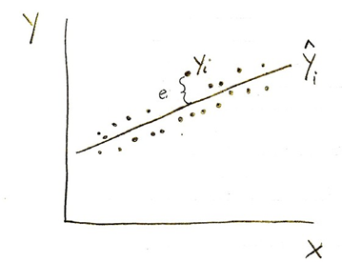
Ŷ_{i} is a point on the regression line
Y_{i} is an individual data value
The deviations of the individual observations (the points) from the regression line, (Y_{i} - Ŷ_{i}), the residuals, are denoted by e_{i} where e_{i} = (Y_{i} - Ŷ_{i}).
Some deviations are positive (for the points above the line); some are negative (for the points below the line). If a point is on the line, its deviation = 0. Note that the Σe_{i} = 0.

Slide 15
Mathematically, the regression line minimizes the sum of the squared errors (SSE):
Σe_{i}² = Σ(Y_{i} - Ŷ_{i})² = Σ[Y_{i} – (b₀ + b₁X_{i})]²
  Regression is called a “least squares” method.
  Taking partial derivatives, we get the “normal equations” that are used to solve for b₀ and b₁.
  In regression, the levels of X are considered to be fixed. Y is the random variable.
  This is why the regression line is called the least squares line. It is the line that minimizes the sum of squared residuals (SSE).
In the example below, we see that most of the points are either above the line or below the line. Only about 5 points are actually on the line or touching it.

Slide 16
Steps in Regression

Slide 18
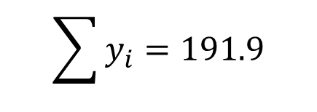
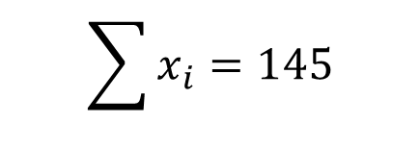
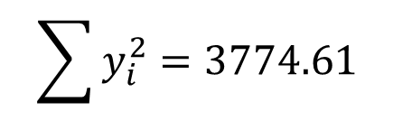
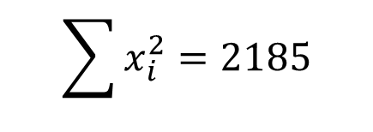
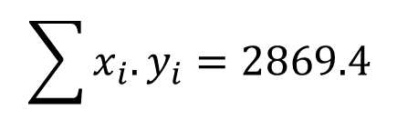
Example: The shear resistance of soil, y (kN/m²), is determined by measurements as a function of the normal stress, x (kN/m²). The data are as shown below:
1- Find the simple linear regression model.
2- State the strength and the nature of the relation between x and y.
x | y
10 | 14.1
11 | 15.6
12 | 16.9
13 | 17.7
14 | 18.3
15 | 20.0
16 | 21.0
17 | 21.7
18 | 22.6
19 | 24.0
Solution: step-1
n=10
 | x | y | x.y | x² | y²
1 | 10 | 14.1 | 141 | 100 | 198.81
2 | 11 | 15.6 | 171.6 | 121 | 243.36
3 | 12 | 16.9 | 202.8 | 144 | 285.61
4 | 13 | 17.7 | 230.1 | 169 | 313.29
5 | 14 | 18.3 | 256.2 | 196 | 334.89
6 | 15 | 20.0 | 300 | 225 | 400
7 | 16 | 21.0 | 336 | 256 | 441
8 | 17 | 21.7 | 368.9 | 289 | 470.89
9 | 18 | 22.6 | 406.8 | 324 | 510.76
10 | 19 | 24.0 | 456 | 361 | 576
sum | 145 | 191.9 | 2869.4 | 2185 | 3774.61
$$\sum{x_{i}}=145$$
$$\sum{y_{i}}=191.9$$
$$\sum{x_{i}.y_{i}}=2869.4$$
$$\sum{x_{i}^{2}}=2185$$
$$\sum{y_{i}^{2}}=3774.61$$

Slide 19
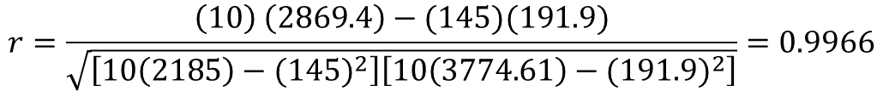
$$r=\frac{\left(10\right) \left(2869.4\right)−(145)(191.9)}{\sqrt{\left[10\left(2185\right)−{(145)}^{2}\right]\left[10\left(3774.61\right)−{(191.9)}^{2}\right]}}=0.9966$$
Therefore the relation is strong and direct.
r² = 0.9966² = 0.993

Slide 20


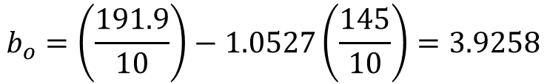
$$b_{1}=\frac{868.5}{825}=1.0527$$
$$b_{o}=\left(\frac{191.9}{10}\right)−1.0527\left(\frac{145}{10}\right)=3.9258$$
$$\overline{Y_{i}}=3.9258+1.0527X_{i}$$

Slide 21
Example: Hours Studied & Grades
Let’s examine the relationship between hours studied and grade on a quiz. n=7 pairs of data. Highest grade on quiz is a 15.
X ≡ hours studied; Y ≡ grade on quiz.
X_{i} | Y_{i} | X_{i}Y_{i} | X_{i}² | Y_{i}²
1 | 5 | 5 | 1 | 25
2 | 8 | 16 | 4 | 64
3 | 9 | 27 | 9 | 81
4 | 10 | 40 | 16 | 100
5 | 11 | 55 | 25 | 121
6 | 12 | 72 | 36 | 144
7 | 14 | 98 | 49 | 196
ΣX= 28 | ΣY= 69 | ΣXY= 313 | ΣX²= 140 | ΣY²= 731

Slide 22
∑X = 28
∑Y = 69
∑XY = 313
∑X² = 140
∑Y² = 731
Calculate the correlation coefficient, r:

Slide 23
Calculate the coefficient of determination, R²:
R² = (0.98)² = .9604
Calculate the regression coefficient b₁ (the slope):
Calculate the regression coefficient b₀ (the Y-intercept, or constant):
b_{o}=(69/7)-1.32(28/7)=4.58
The regression equation:

